Slide 1
2019
Sonnen Accredited Installer Training

Slide 2


Products & Innovation.
Accreditation Pathways & Renewal
Accreditation Type
Provisional Accreditation
Full Accreditation
1: View the online training module
2: Complete the online assessment with a 90%+ pass mark
1: View the online training module
2: Complete the online assessment with a 90%+ pass mark
Requirements
Complete x10 sonnen installations
(systems installed in excess of the x10 within the previous year can carry over to the current year)
2nd level response to support matters
Pre-arranged remote installation support for the first system installation
Service & Support Entitlements
Same day priority response to service and support matters
Call back service
Validation Period
12 Months
12 Months

Slide 3

Products & Innovation.
Accreditation Awards
All successful accredited training participants will received a certificate of completion.
Installers that obtain Full Accreditation status will also receive the accredited installer unique ID card.
sonnenBatterie Installer Accrediation

Slide 4



sonnen.
Ongoing Installer Support via the
Sonnen Support Website

Slide 5
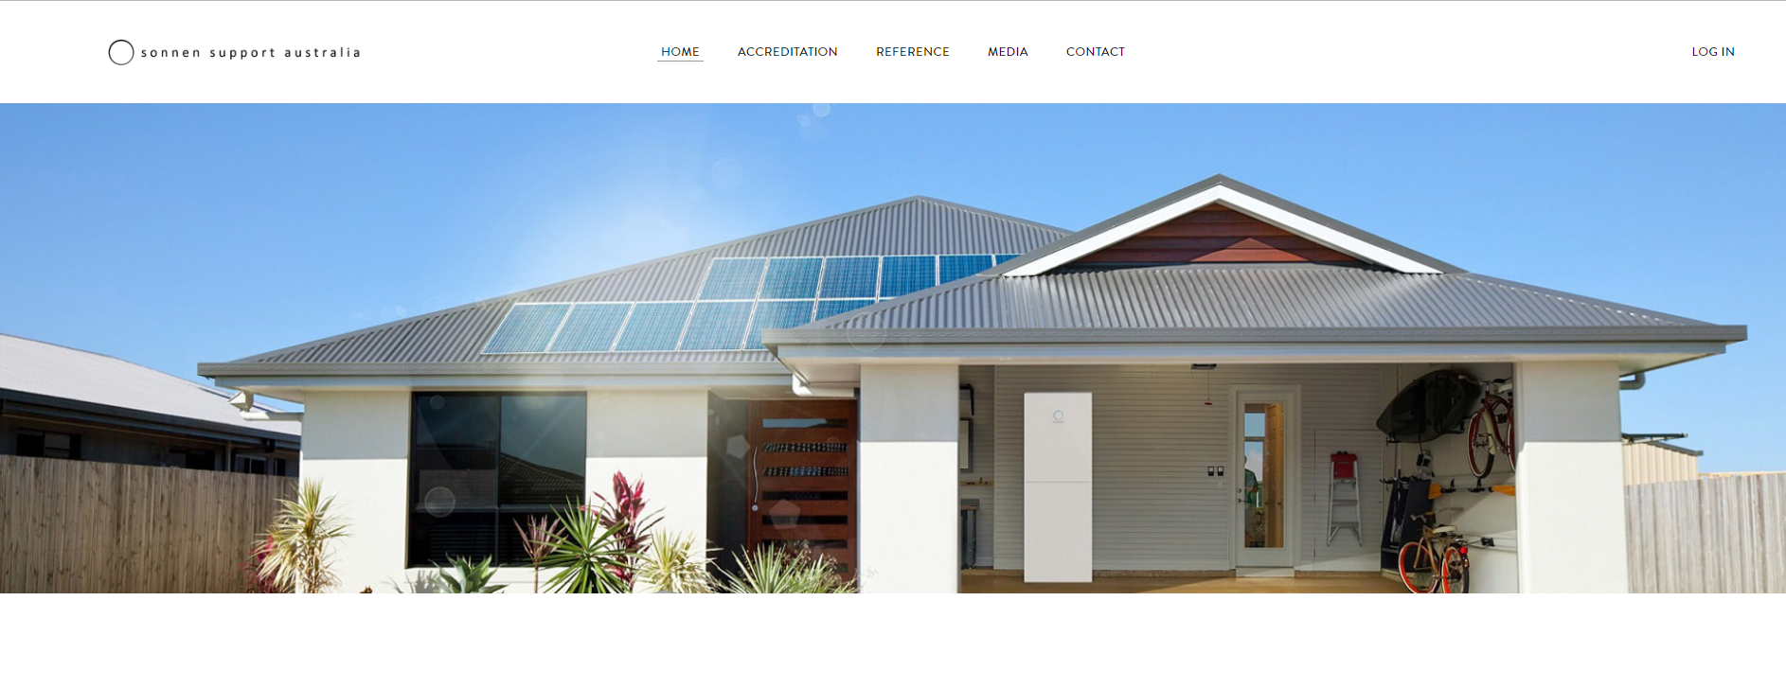
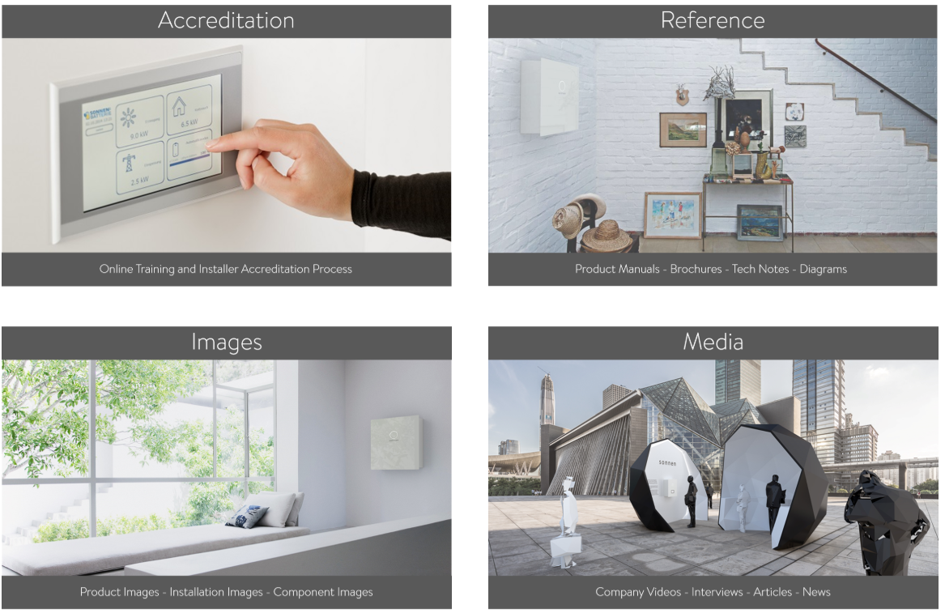
The Accreditation region contains the online installer training resource
The Reference region contains all product data sheets, manuals as well as tech notes and installation guides
The Images region contains pics of common system parts for installers to familiarise themselves with components prior to installations
The Media region contains links to features and articles discussing the sonnen products and systems.

Slide 6
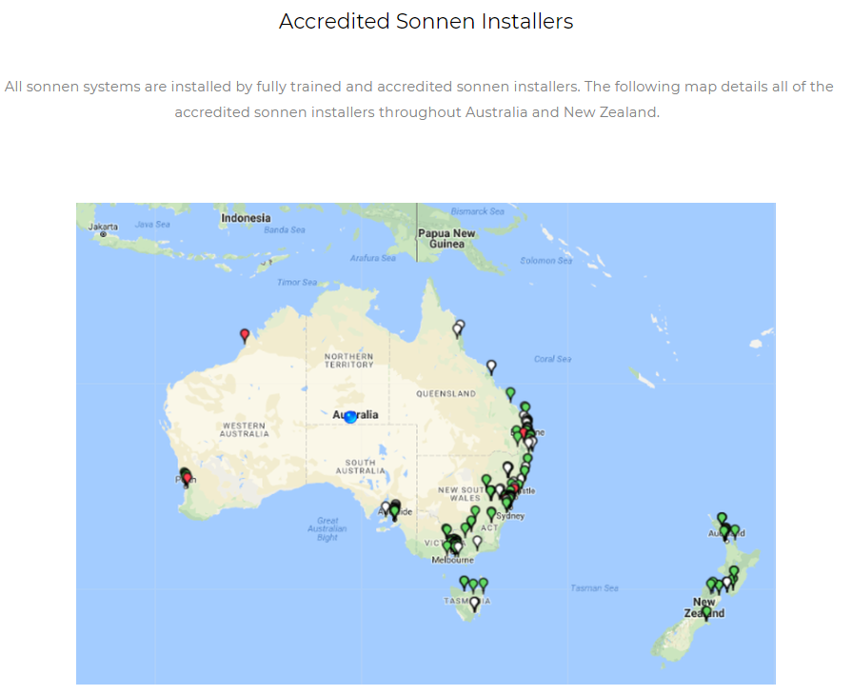
Installers who supply their full contact details when registering for the Installers Assessment will automatically be included onto the sonnen AU/NZ installers map.
The sonnen AU/NZ installers map details installers with Full, Provisional as well as Expired accreditation.

Slide 7

The sonnen Globe which is also on the Main Page of the support website details a live global map of all installed sonnen systems.
The map helps to visualise how all of our installation can be linked together to enable the sharing of energy between system owners.

Slide 9
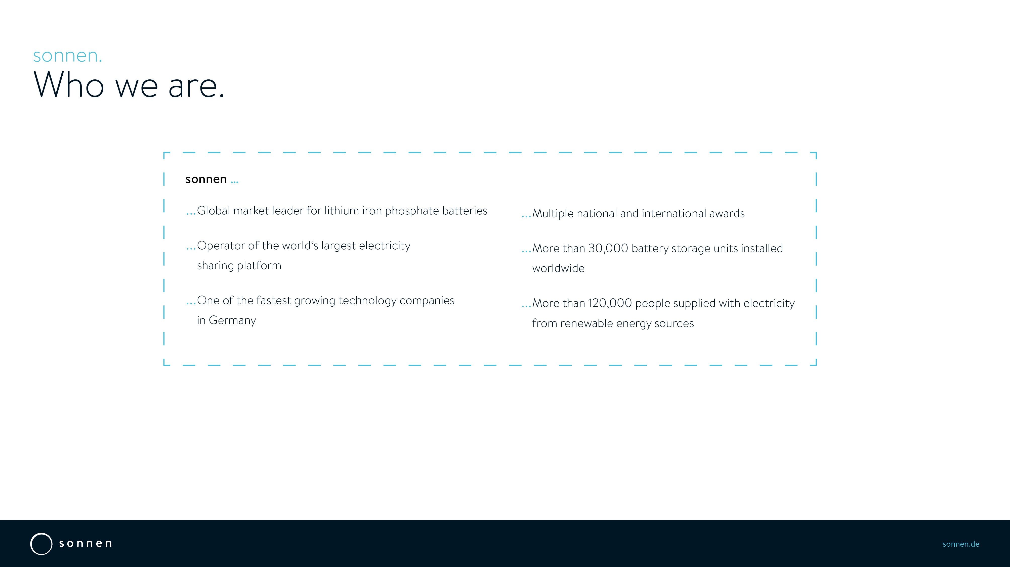
… Global market leader for Lithium Iron Phosphate (LFP) battery systems
… Operator of the world’s largest electricity sharing platform
… One of the fastest growing technology companies in Germany
… Multiple national and international awards
… More than 45,000 battery storage units installed worldwide
… More than 120,000 people supplied with electricity from renewable energy sources

Slide 10
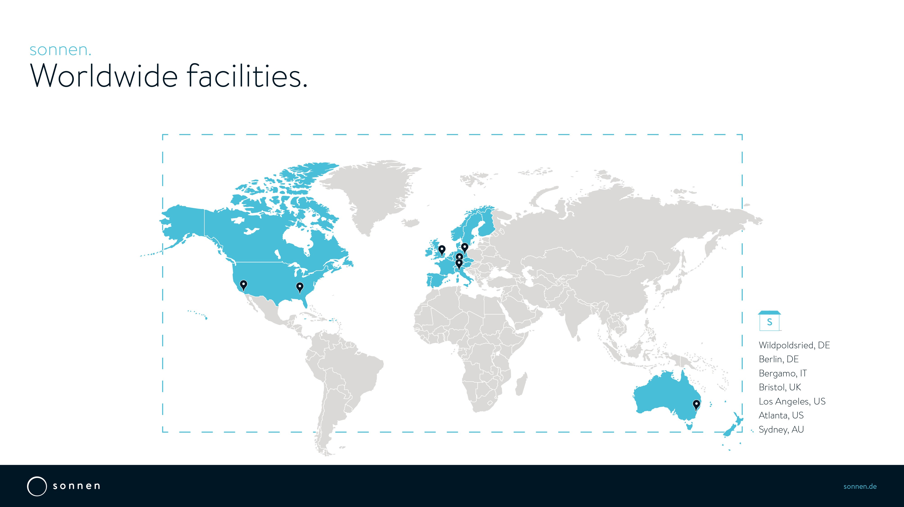

Slide 11


Slide 12
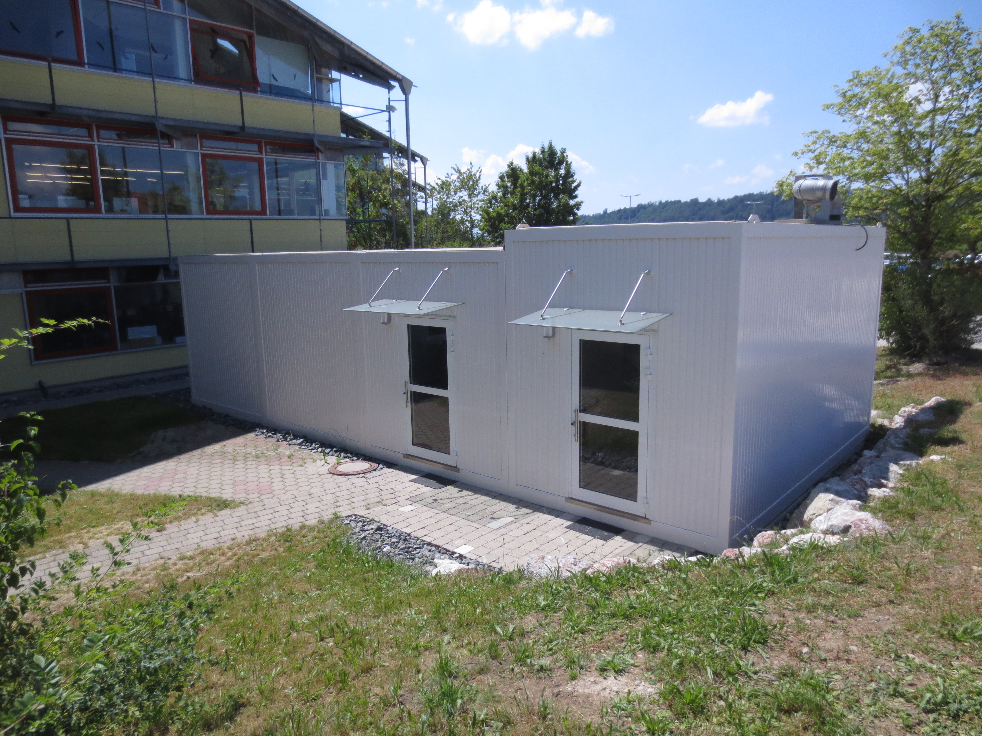

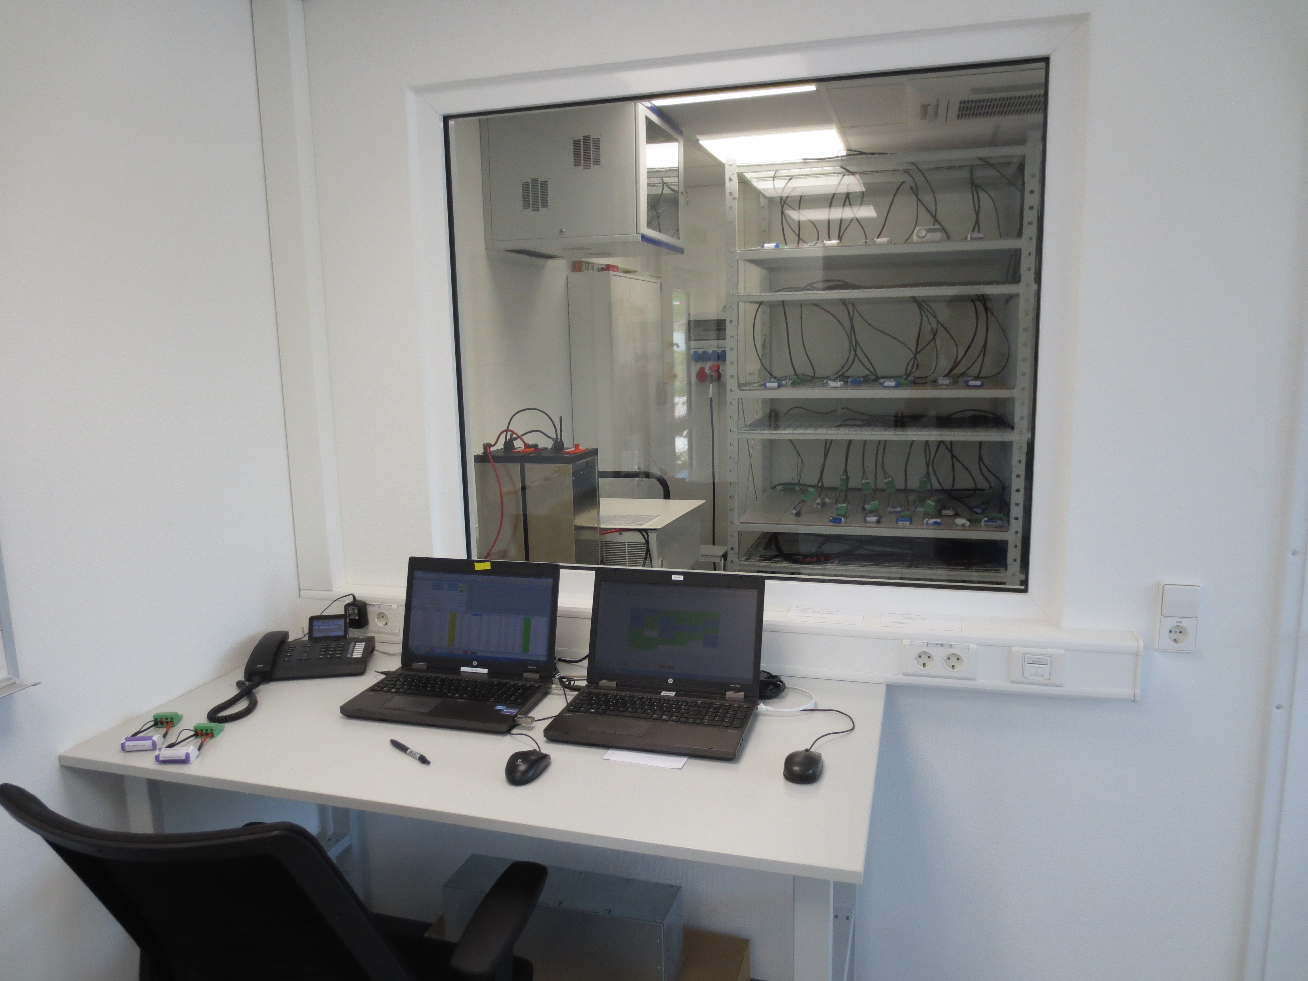
Products & Innovation.
Product Development at sonnen.
Battery Lab
150+ Engineers.
in Wildpoldsried, Berlin and Atlanta.
5 Departments for Product Innovation.
Business Innovation, R&D Device, R&D Digital,
R&D VPP, Product Management.

Slide 13
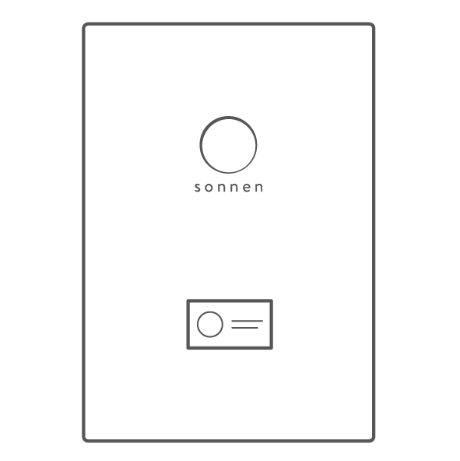
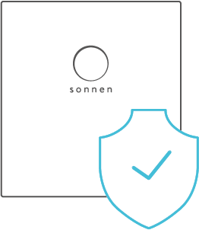

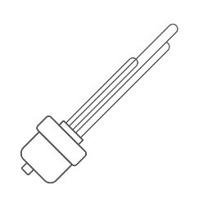
Products & Innovation.
Product Portfolio.
sonnenBatteries
Smart Home Accessories
Backup Accessories
Three-Phase
Single-Phase
Split-Phase
AC-Coupled
DC-Hybrid
Innovative accessories to maximise the value for the customer and add loads to sonnen‘s Virtual Power Plant (VPP)
Energy Security for Homeowners

Slide 14
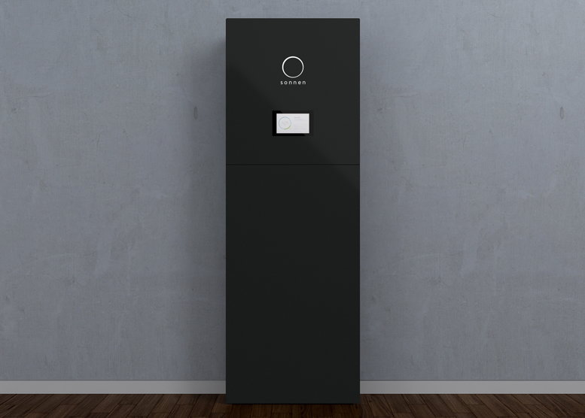
Products & Innovation.
Five reasons for sonnen.
Safe
Thanks to Lithium-Iron-Phosphate
Long lasting
10 years, 10.000 cycles
Economical
Zero Dollar Bill with sonnenFlat
Integrated
All-In-One-Solution
Proven
Market leading Technology

Slide 15
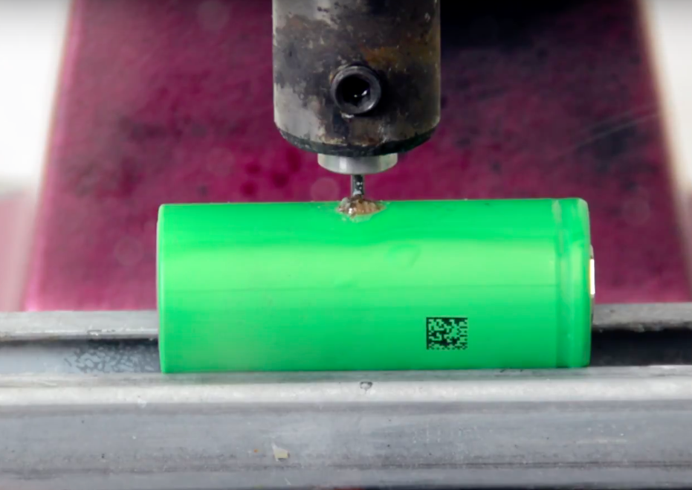
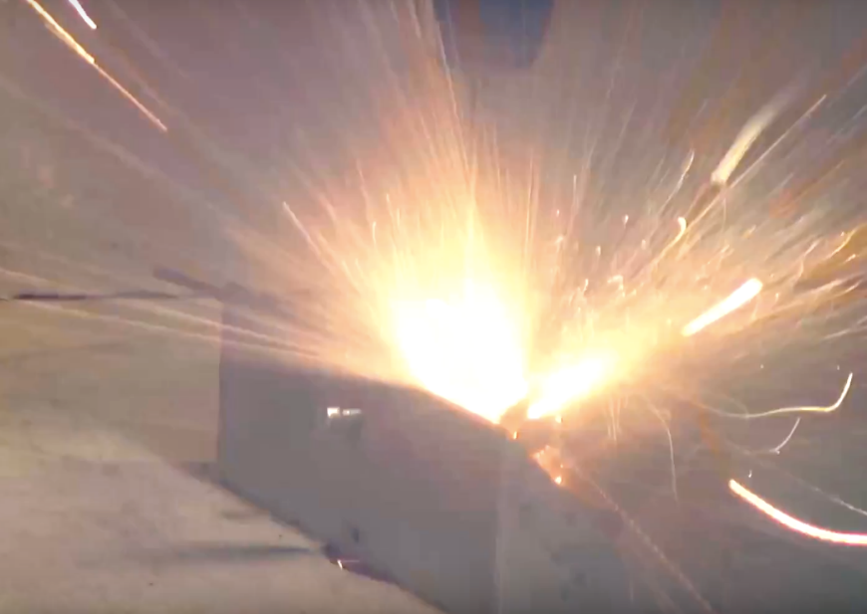

Products & Innovation.
Five reasons for sonnen.
LFP
NMC
Safe
Thanks to Lithium-Iron-Phosphate
Long lasting
10 years, 10.000 cycles
Economical
Zero Dollar Bill with sonnenFlat
Integrated
All-In-One-Solution
Proven
Market leading Technology
VS
Lithium-Iron-Phosphate (LFP):
Safe, long lasting, available.

Slide 16
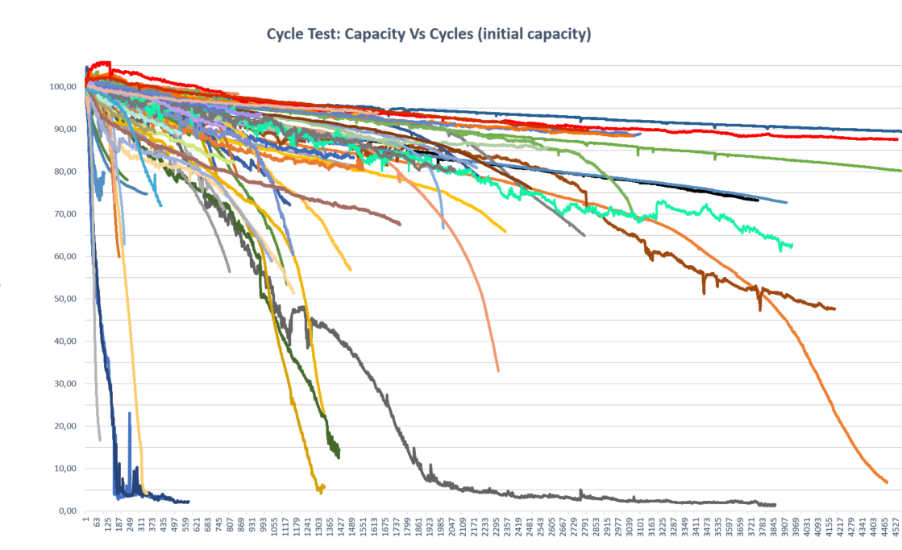
Products & Innovation.
Five reasons for sonnen.
Safe
Thanks to Lithium-Iron-Phosphate
Long lasting
10 years, 10.000 cycles
Economical
Zero Dollar Bill with sonnenFlat
Integrated
All-In-One-Solution
Proven
Market leading Technology
sonnen LFP2
Sony / Murata

Slide 17
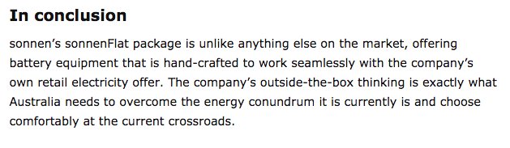
Products & Innovation.
Five reasons for sonnen.
Safe
Thanks to Lithium-Iron-Phosphate
Long lasting
10 years, 10.000 cycles
Economical
Zero Dollar Bill with sonnenFlat
Integrated
All-In-One-Solution
Proven
Market leading Technology
0$
solarchoice.net.au

Slide 18
Products & Innovation.
Five reasons for sonnen.
Safe
Thanks to Lithium-Iron-Phosphate
Long lasting
10 years, 10.000 cycles
Economical
Zero Dollar Bill with sonnenFlat
Integrated
All-In-One-Solution
Proven
Market leading Technology
Inverter
Energy Manager
Switch
sonnenBatterie
Battery

Slide 19
Products & Innovation.
Five reasons for sonnen.
Safe
Thanks to Lithium-Iron-Phosphate
Long lasting
10 years, 10.000 cycles
Economical
Zero Dollar Bill with sonnenFlat
Integrated
All-In-One-Solution
Proven
Market leading Technology
Warranty
Warranty
Service
Experience
Warranty
Warranty
Inverter
Energy Manager
Zähler
Service
Service
Service
Experience
Experience
Experience
Warranty
sonnenBatterie
Battery
Service
Experience

Slide 20
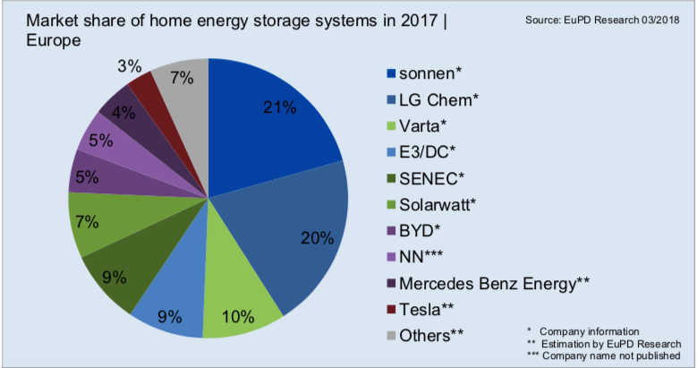




Products & Innovation.
Five reasons for sonnen.
Safe
Thanks to Lithium-Iron-Phosphate
Long lasting
10 years, 10.000 cycles
Economical
Zer0 Dollar Bill with sonnenFlat
Integrated
All-In-One-Solution
Proven
Market leading Technology
Global Market Leader
9th Generation Products
45,000+ Systems sold

Slide 21

Products & Innovation.
Product portfolio from sonnen.
AC Coupled
eco 8.2 / eco 9.43 single-phase
eco 8.0 / eco 8.03 three-phase
DC Hybrid
eco 9.53 single-phase
eco 8.1 / eco 8.13 three-phase
Accessories
sonnenProtect
sonnenBackup
IP Rated Enclosure
Control
VPP
Z-Wave
Smart Home Integrated

Slide 22
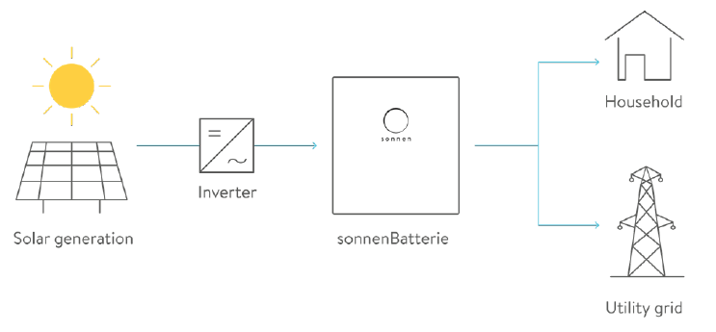
Products & Innovation.
Product portfolio from sonnen.
AC Coupled
eco 8.2 / eco 9.43 single-phase
eco 8.0 / eco 8.03 three-phase
Scalable Solutions
2kW to 16kW Sony/Murata
2.5kW to 15kW LFP2
10 years, 10,000 cycles

Slide 23
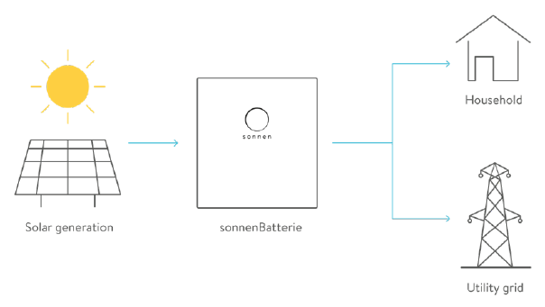
Products & Innovation.
Product portfolio from sonnen.
DC Hybrid
eco 9.53 single-phase
eco 8.1 / eco 8.13 three-phase
Scalable Solutions
2kW to 16kW Sony/Murata
2.5kW to 15kW LFP2
10 years, 10,000 cycles

Slide 24
sonnen.
Installer Training

Slide 25


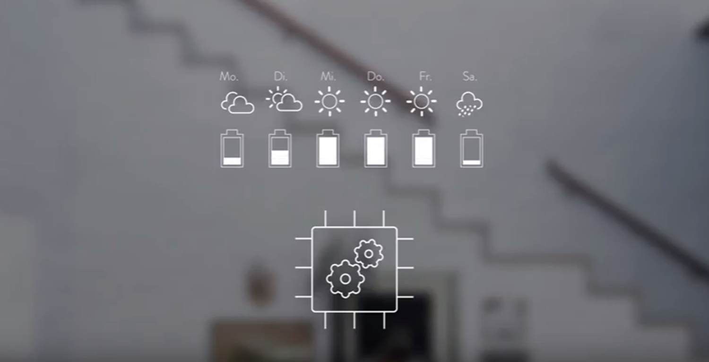
Sonnen Product Specifications

Slide 26
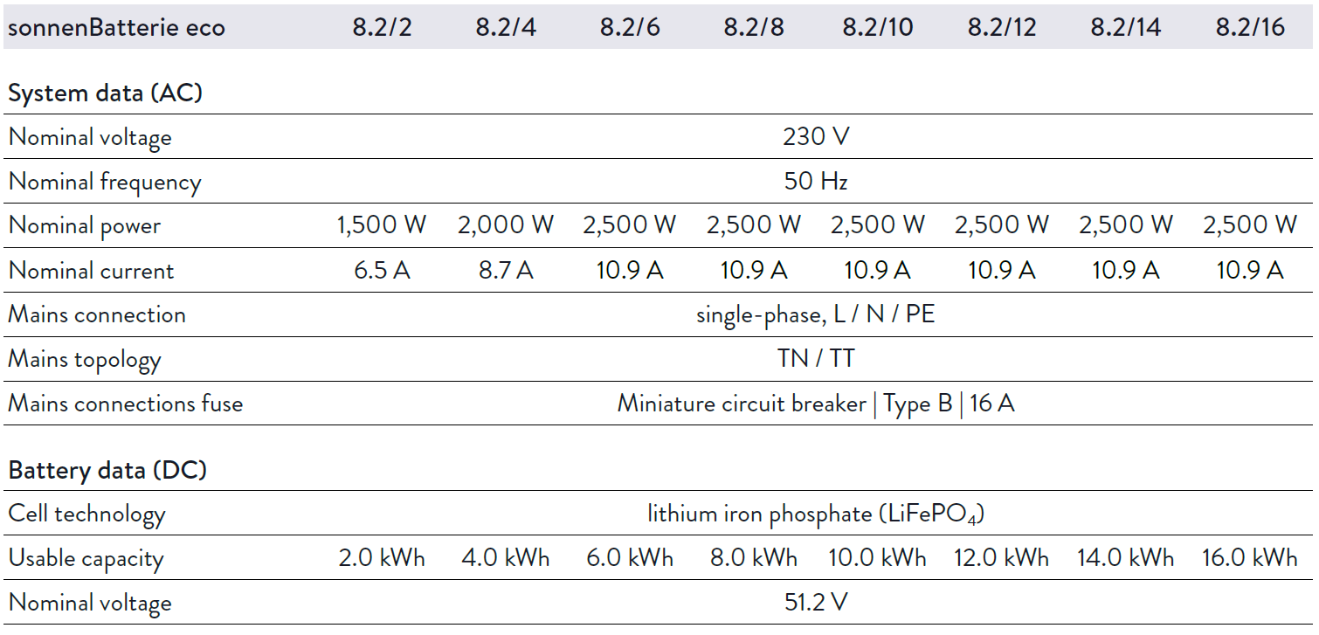
Products & Innovation.
Product Specifications – AC coupled – Single Phase – sonnenBatterie eco 8.2

Slide 27
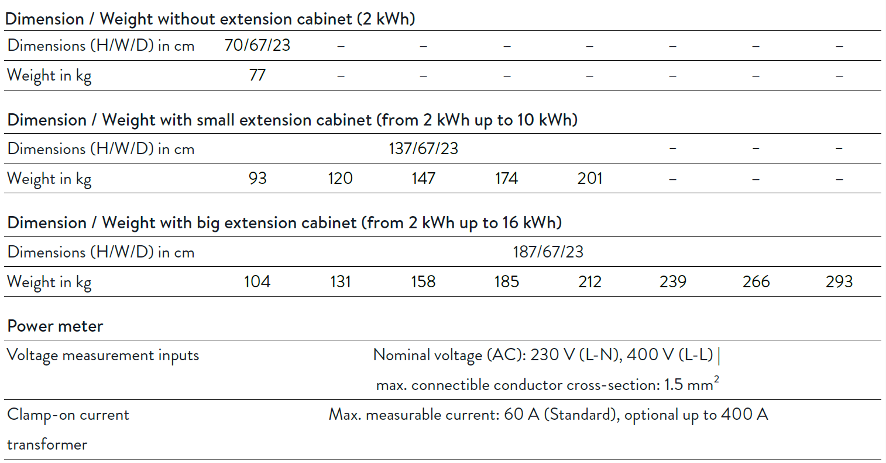
Products & Innovation.
Product Specifications – AC coupled – Single Phase – sonnenBatterie eco 8.2

Slide 28
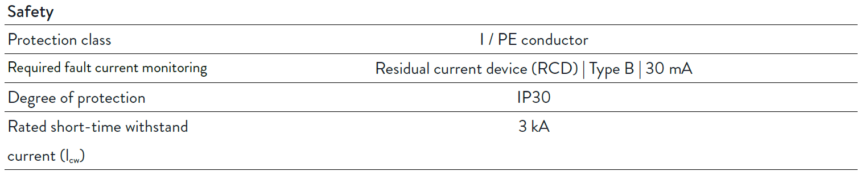
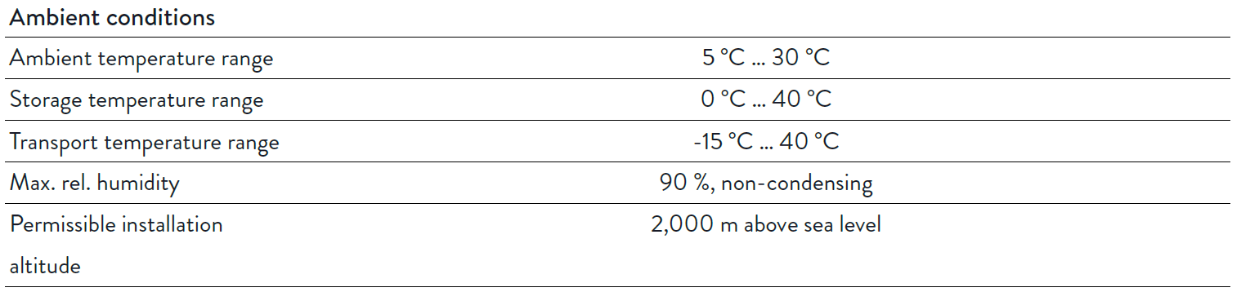
Products & Innovation.
Product Specifications – AC coupled – Single Phase – sonnenBatterie eco 8.2

Slide 29
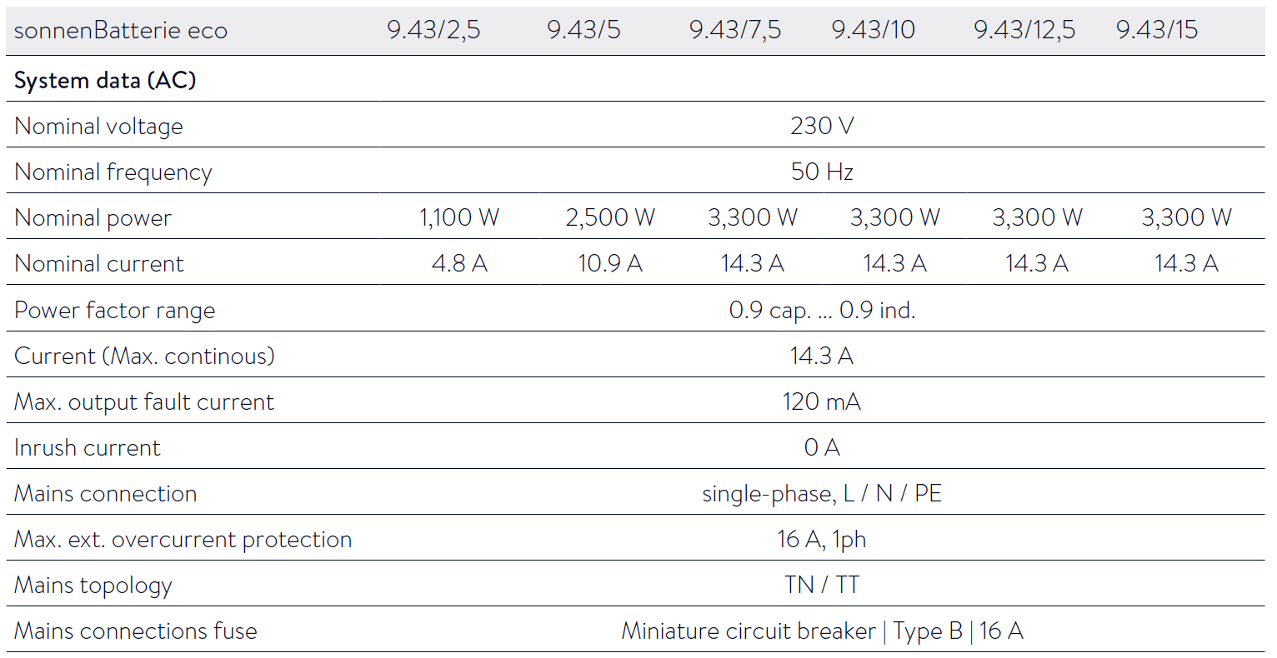
Products & Innovation.
Product Specifications – AC coupled – Single Phase – sonnenBatterie eco 9.43

Slide 30
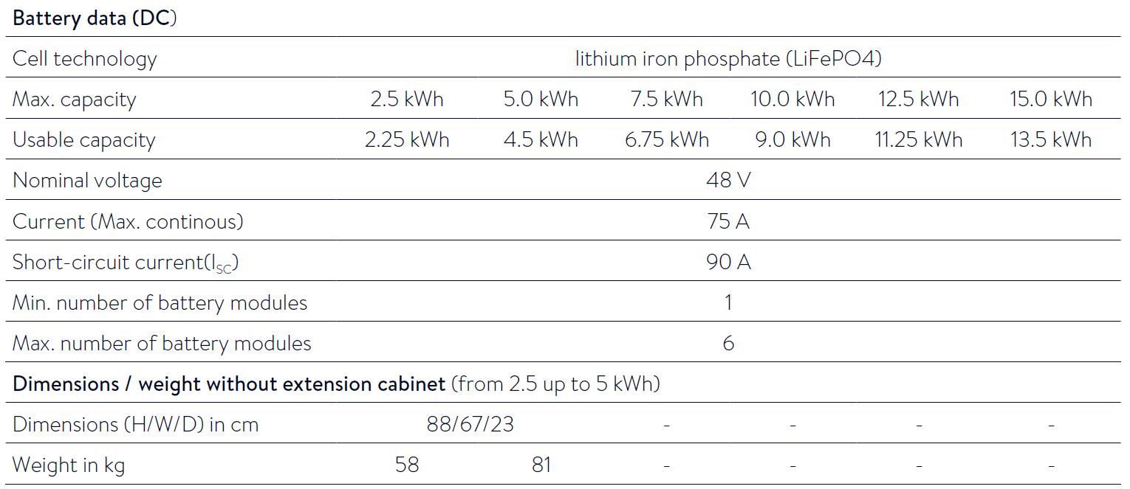
Products & Innovation.
Product Specifications – AC coupled – Single Phase – sonnenBatterie eco 9.43

Slide 31
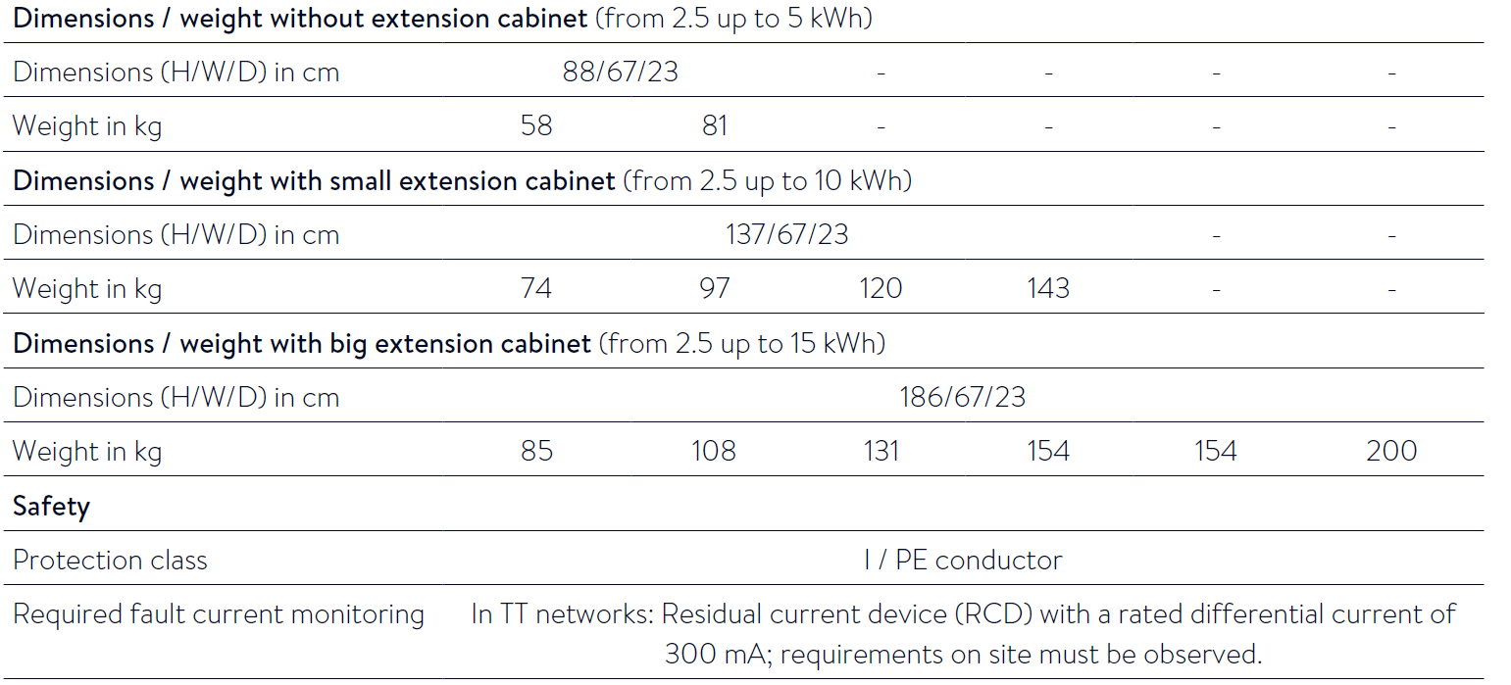
Products & Innovation.
Product Specifications – AC coupled – Single Phase – sonnenBatterie eco 9.43

Slide 32
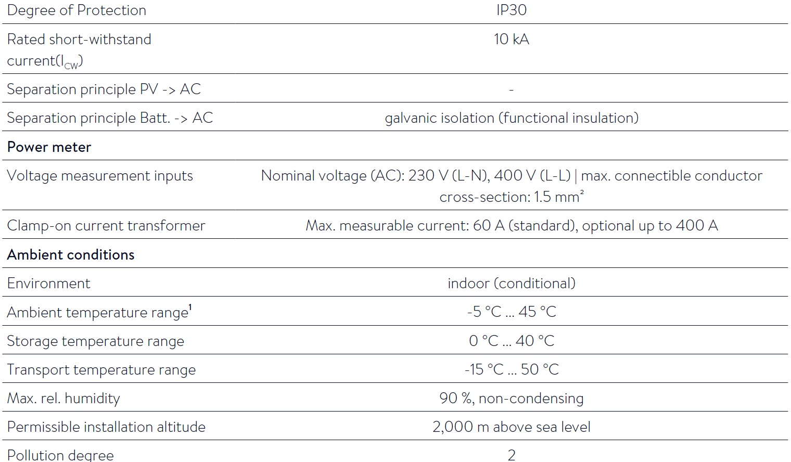
Products & Innovation.
Product Specifications – AC coupled – Single Phase – sonnenBatterie eco 9.43

Slide 33
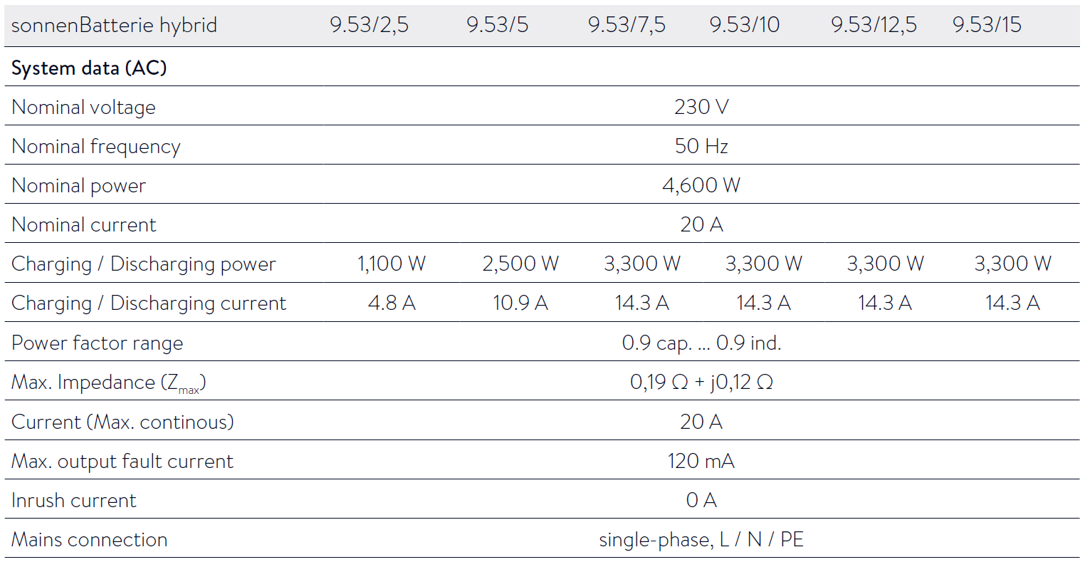
Products & Innovation.
Product Specifications – DC Hybrid – Single Phase – sonnenBatterie eco 9.53

Slide 34
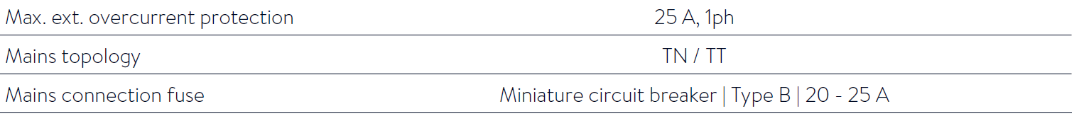
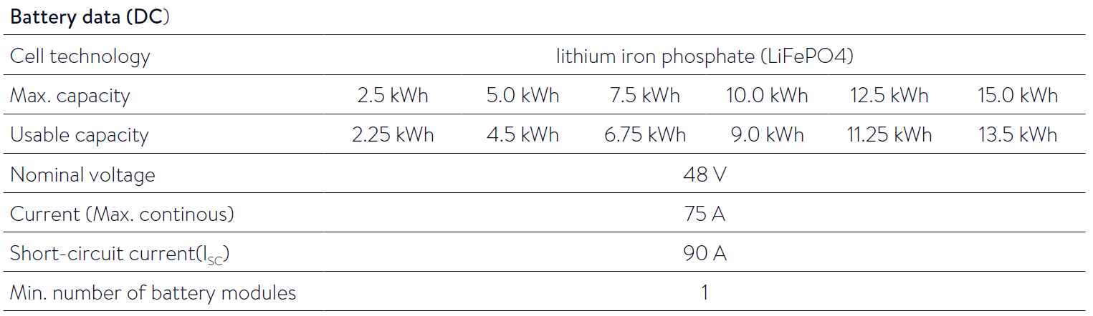
Products & Innovation.
Product Specifications – DC Hybrid – Single Phase – sonnenBatterie eco 9.53

Slide 35
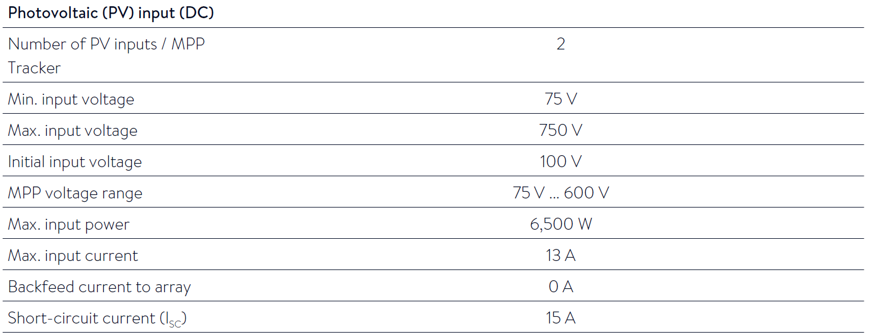
Products & Innovation.
Product Specifications – DC Hybrid – Single Phase – sonnenBatterie eco 9.53

Slide 36
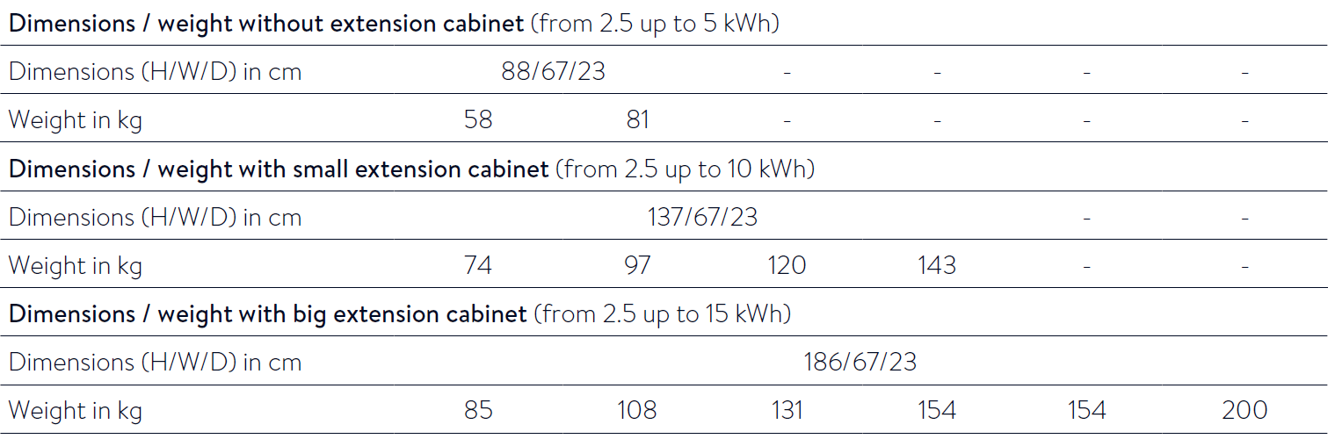
Products & Innovation.
Product Specifications – DC Hybrid – Single Phase – sonnenBatterie eco 9.53

Slide 37
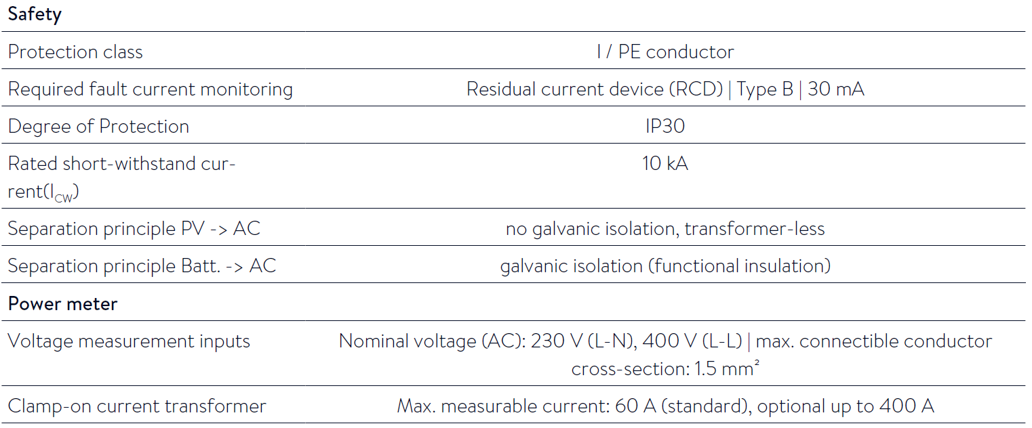
Products & Innovation.
Product Specifications – DC Hybrid – Single Phase – sonnenBatterie eco 9.53

Slide 38
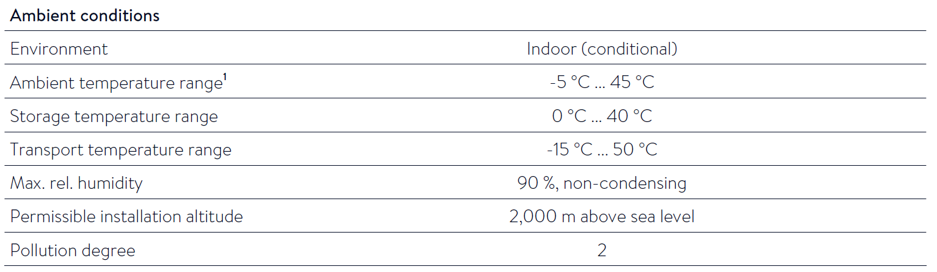
Products & Innovation.
Product Specifications – DC Hybrid – Single Phase – sonnenBatterie eco 9.53

Slide 39
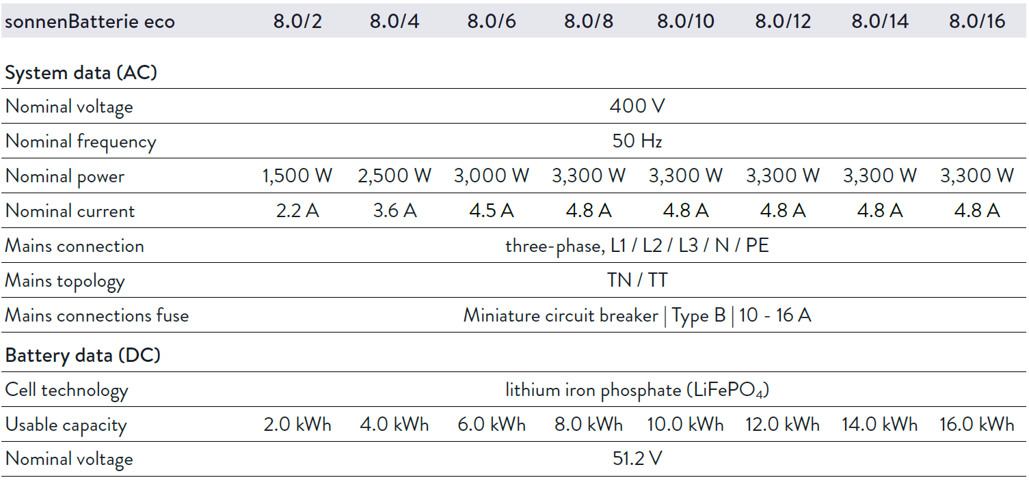
Products & Innovation.
Product Specifications – AC Coupled – Three Phase – sonnenBatterie eco 8.0

Slide 40
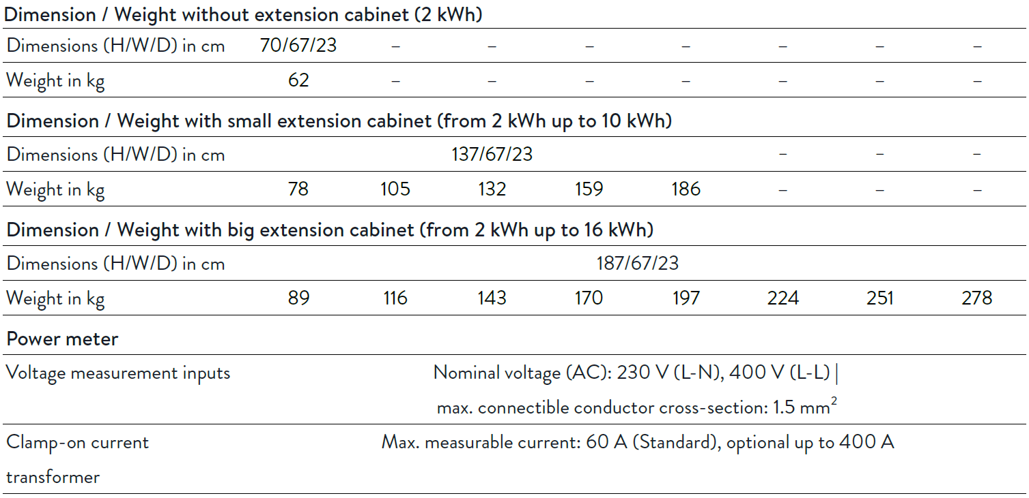
Products & Innovation.
Product Specifications – AC Coupled – Three Phase – sonnenBatterie eco 8.0

Slide 41
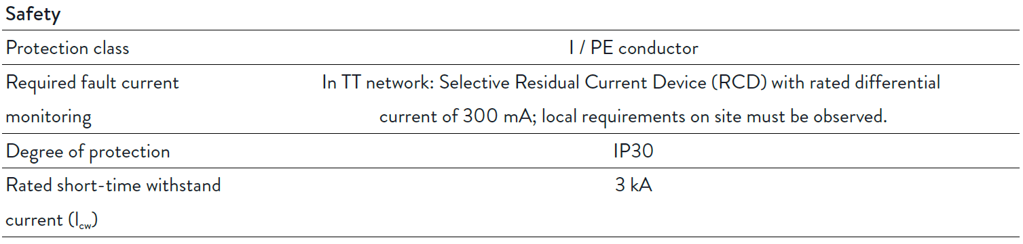
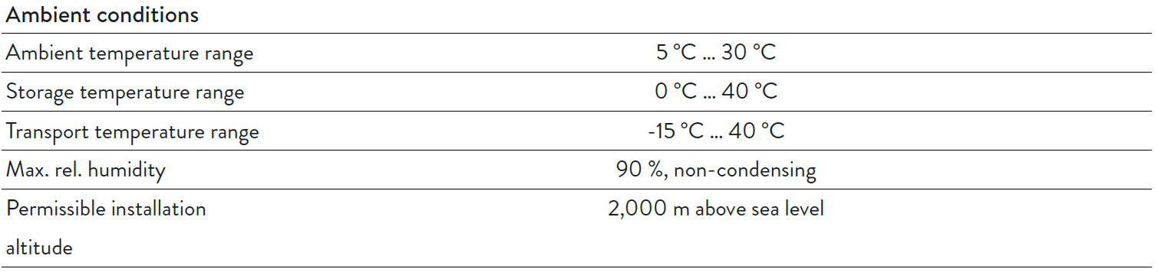
Products & Innovation.
Product Specifications – AC Coupled – Three Phase – sonnenBatterie eco 8.0

Slide 42
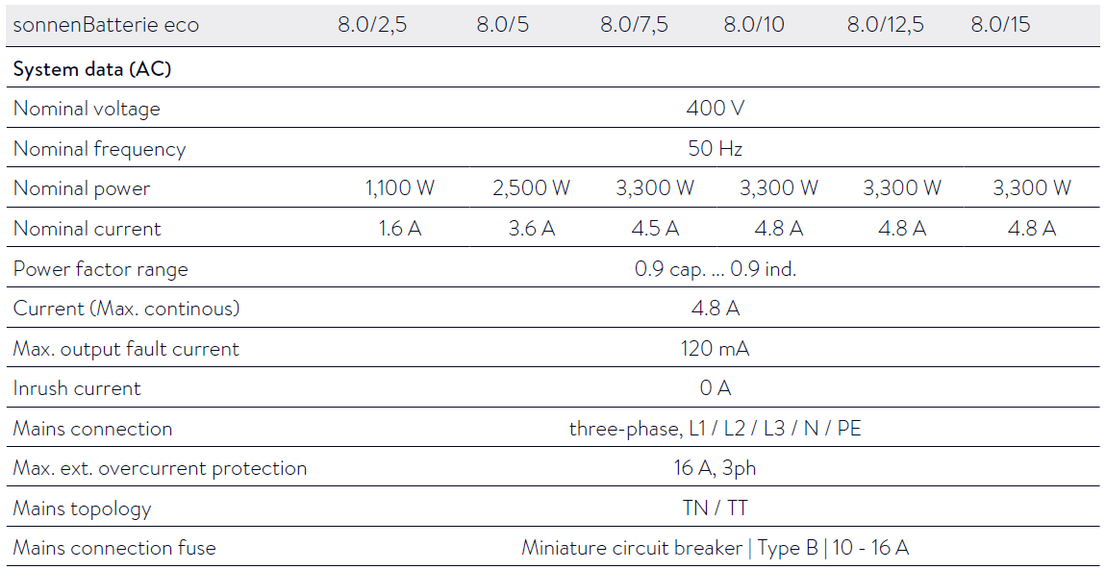
Products & Innovation.
Product Specifications – AC Coupled – Three Phase – sonnenBatterie eco 8.03

Slide 43
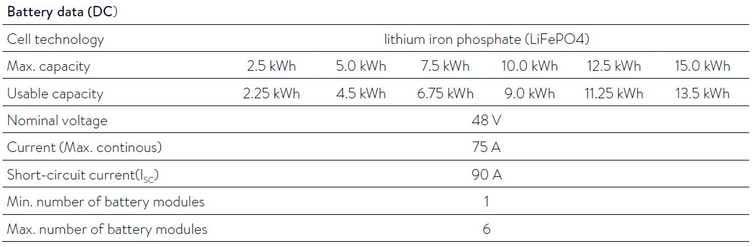
Products & Innovation.
Product Specifications – AC Coupled – Three Phase – sonnenBatterie eco 8.03

Slide 44
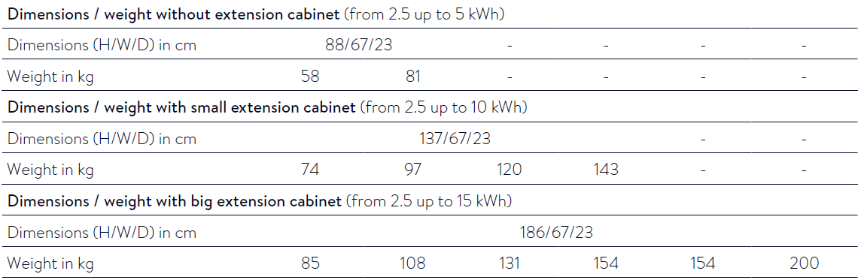
Products & Innovation.
Product Specifications – AC Coupled – Three Phase – sonnenBatterie eco 8.03

Slide 45
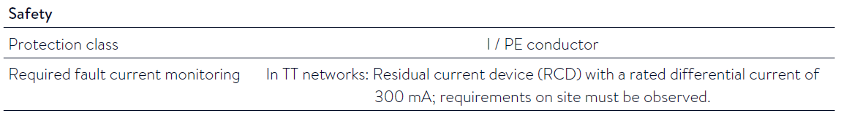
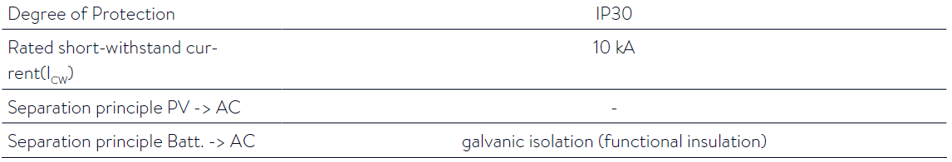
Products & Innovation.
Product Specifications – AC Coupled – Three Phase – sonnenBatterie eco 8.03

Slide 46
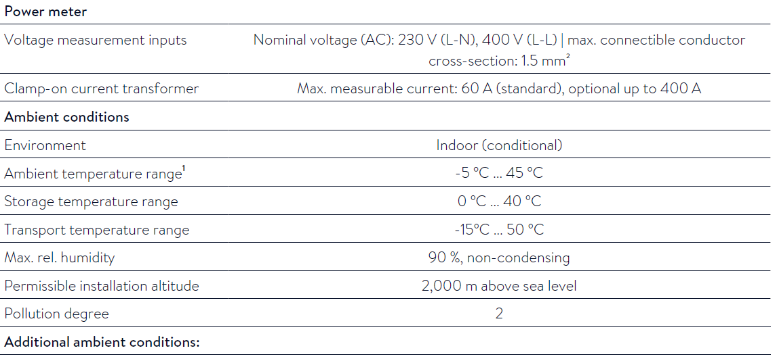
Products & Innovation.
Product Specifications – AC Coupled – Three Phase – sonnenBatterie eco 8.03

Slide 47
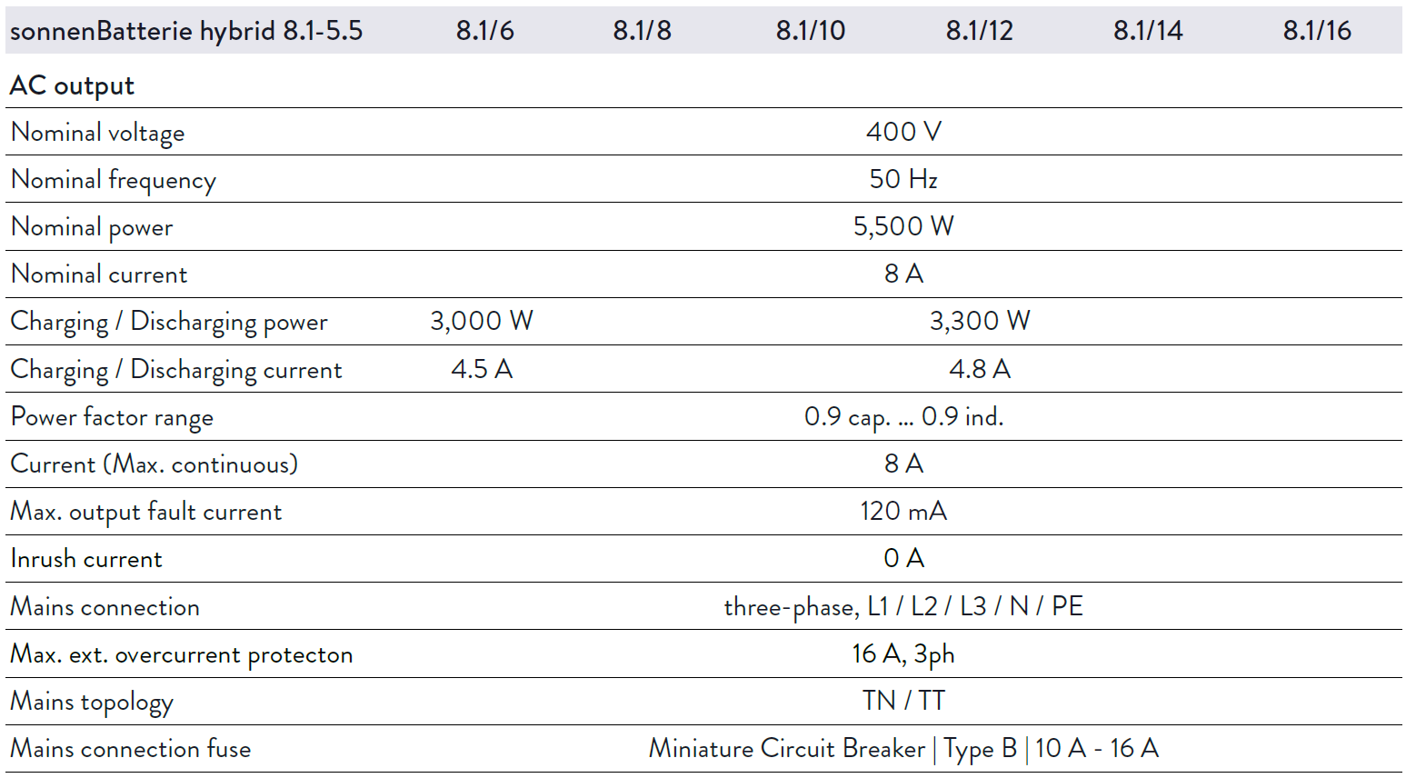
Products & Innovation.
Product Specifications – DC Hybrid – Three Phase – sonnenBatterie eco Hybrid 8.1

Slide 48
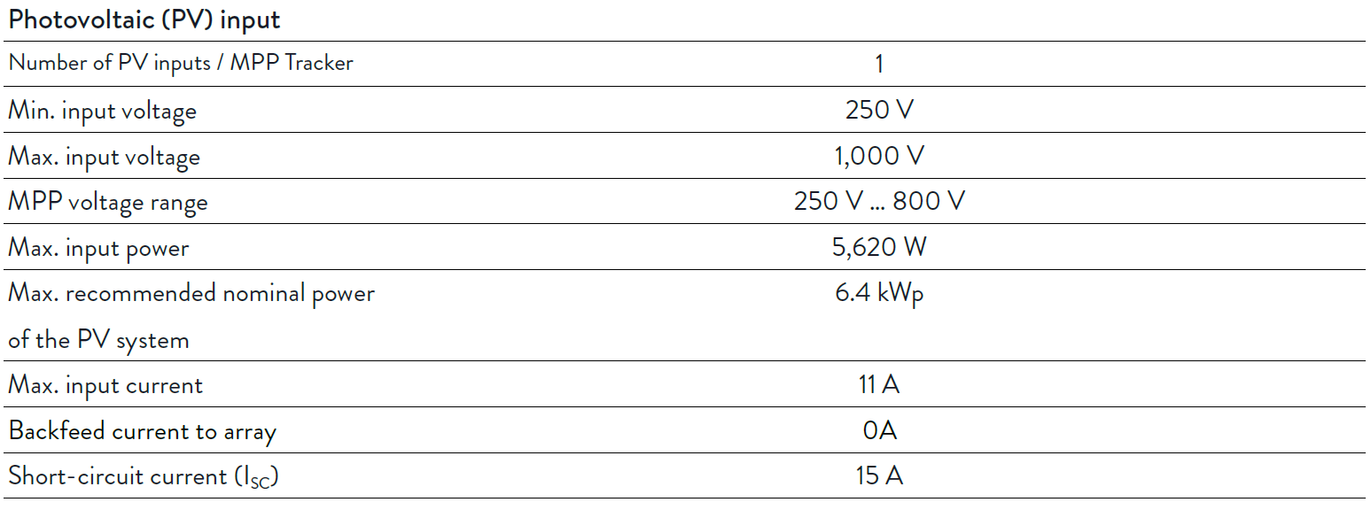
Products & Innovation.
Product Specifications – DC Hybrid – Three Phase – sonnenBatterie eco Hybrid 8.1

Slide 49
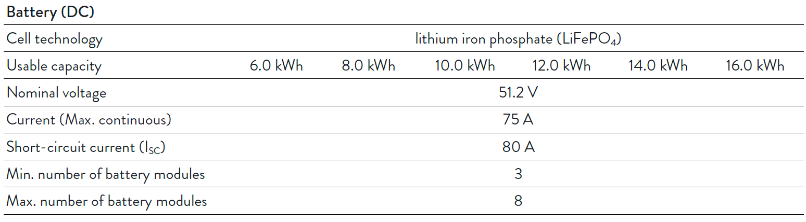
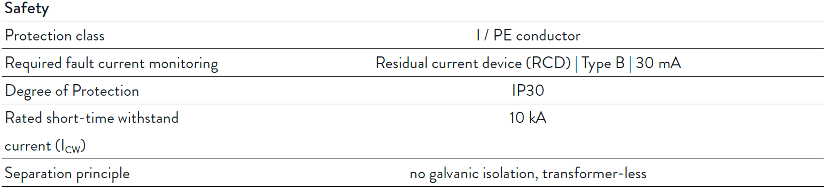
Products & Innovation.
Product Specifications – DC Hybrid – Three Phase – sonnenBatterie eco Hybrid 8.1

Slide 50
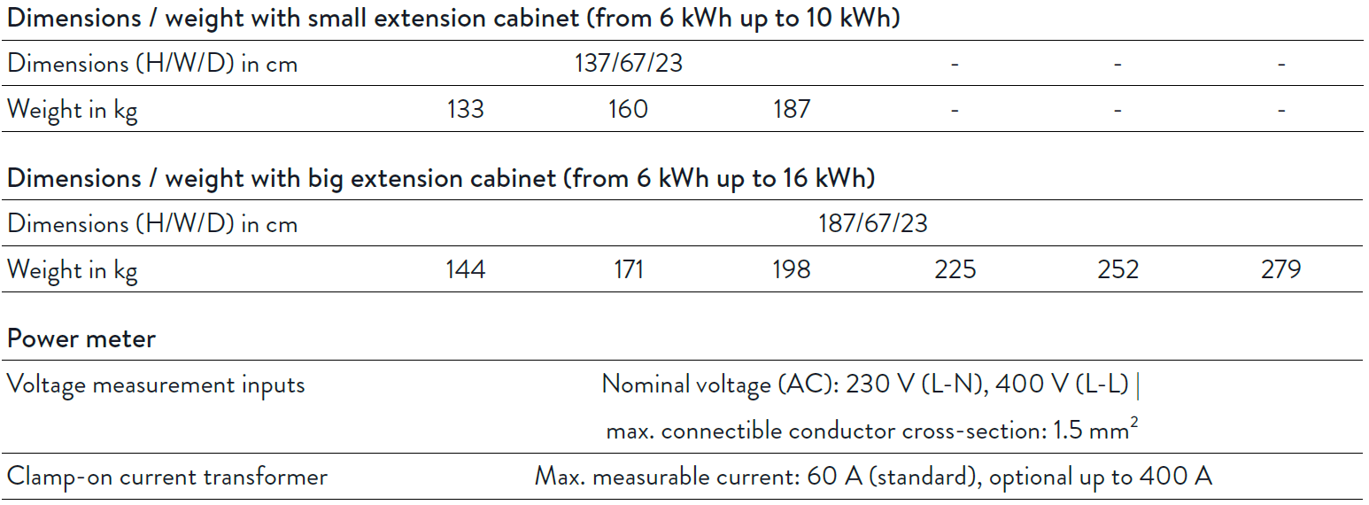
Products & Innovation.
Product Specifications – DC Hybrid – Three Phase – sonnenBatterie eco Hybrid 8.1

Slide 51
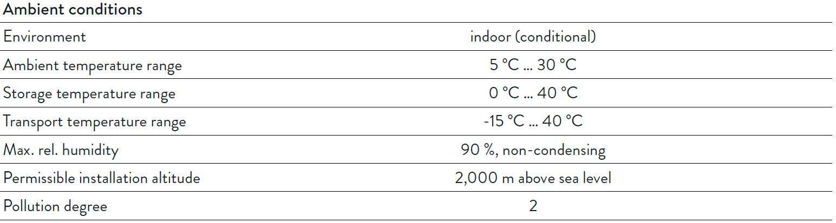
Products & Innovation.
Product Specifications – DC Hybrid – Three Phase – sonnenBatterie eco Hybrid 8.1

Slide 52

Products & Innovation.
Product Specifications – DC Hybrid – Three Phase – sonnenBatterie eco Hybrid 8.13

Slide 53

Products & Innovation.
Product Specifications – DC Hybrid – Three Phase – sonnenBatterie eco Hybrid 8.13

Slide 54

Products & Innovation.
Product Specifications – DC Hybrid – Three Phase – sonnenBatterie eco Hybrid 8.13

Slide 55


Products & Innovation.
Product Specifications – DC Hybrid – Three Phase – sonnenBatterie eco Hybrid 8.13

Slide 56


Products & Innovation.
Product Specifications – DC Hybrid – Three Phase – sonnenBatterie eco Hybrid 8.13

Slide 57
Bill of Materials

Slide 58






Products & Innovation.
Bill of Materials – AC Coupled – Single Phase – sonnenBatterie eco 8.2

Slide 59






Products & Innovation.
Bill of Materials – AC Coupled – Single Phase – sonnenBatterie eco 9.43

Slide 60





Products & Innovation.
Bill of Materials – DC Hybrid – Single Phase – sonnenBatterie eco Hybrid 9.53

Slide 61






Products & Innovation.
Bill of Materials – AC Coupled – Three Phase – sonnenBatterie eco 8.0

Slide 62





Products & Innovation.
Bill of Materials – AC Coupled – Three Phase – sonnenBatterie eco 8.03

Slide 63






Products & Innovation.
Bill of Materials – DC Hybrid – Three Phase – sonnenBatterie eco Hybrid 8.1

Slide 64





Products & Innovation.
Bill of Materials – DC Hybrid – Three Phase – sonnenBatterie eco Hybrid 8.13

Slide 65
Mounting the Enclosures

Slide 66



Products & Innovation.
Mounting the Enclosures – Location Selection
    Component Options.
    The storage system with the optional extension cabinet must be floor mounted.
    A storage system without the optional extension cabinet must be mounted to the wall with screws.
    Use only screws with the following properties:
      The diameter of the screw head (see figure) must be between 13 mm and 15 mm.
      The screw diameter must be 8 mm.
      The screw head must not exceed 5mm.

Slide 67

Products & Innovation.
Mounting the Enclosures – Location Selection
    Observing minimum distances.
    Observe the specified minimum distances to neighboring objects.
    The minimum distances ensure that:
      there is sufficient heat dissipation, the storage system door can be opened easily and
      there is sufficient space for maintenance work.

Slide 68


Products & Innovation.
Mounting the Enclosures – Location Positioning
    For storage systems consisting of main and small extension cabinet:
    Drill the holes shown in red in figure on the left.
    Note that the storage system must be placed on the levelling mat or the pedestal (C).
    Without extension cabinet:
    If the storage system is used without extension cabinet it is a good idea to observe the dimensions provided in one of the two figures. That way no new holes need to be drilled if the storage system is extended at a later time.
    8.0 / 8.1 / 8.2
    8.03 / 8.13 / 9.43 / 9.53

Slide 69

Products & Innovation.
Mounting the Enclosures – Location Positioning
    Use the template supplied.
    Mark the fixing positions.
      Depending upon the wall structure wall plugs or anchors can be fitted to hang the units.

Slide 70



Products & Innovation.
Mounting the Enclosures – Location Positioning – Levelling Mat
    The levelling mat (1) is part of the scope of delivery for the extension cabinet. It is used to compensate uneven floors.
    Alternatively the extension cabinet can be placed on an optional pedestal (3) instead of the levelling mat.
    This is helpful if the extension cabinet doesn´t meet flush with the wall (e.g. because a skirting board is mounted)..
    Place the levelling mat or the pedestal at the preferred installation location.

Slide 71




Products & Innovation.
Mounting the Enclosures – Location Positioning – Wall Fixing
    There are keyhole fixings on the rear of the main cabinet.
    The main cabinet is mounted using these attachments..
    The screw should not be completely screwed in.
    The screw head should protrude from the wall by approx. 2 mm

Slide 72




Products & Innovation.
Mounting the Enclosures – Location Positioning – Hanging Enclosures
    Remove the blind caps that are located at the bottom of the main cabinet.

Slide 73




Products & Innovation.
Mounting the Enclosures – Location Positioning – Opening Enclosures

Slide 74



Products & Innovation.
Mounting the Enclosures – Location Positioning – Earth Strap
    A flat braided earth connector strap is already fitted to the extension cabinet.
    Connect the other end of the earth conductor to the earth bolt in the main cabinet.

Slide 75



Products & Innovation.
Mounting the Enclosures – Location Positioning – Access Covers

Slide 76
Battery Module Installation

Slide 77



Products & Innovation.
Battery Module Installation – Sony / Murata Modules – eco 8.0 / Hybrid 8.1 / eco 8.2
    Risk of Burns:
    Very high short-circuit currents are possible and the following must be observed when working with the battery modules:
    The battery module is activated when the fuse connector is plugged in. The voltage runs between the plus and minus contacts of the battery module (nominal voltage of battery modules 51.2 V DC).
    The battery module is deactivated when the fuse connector is unplugged. No voltage runs between the plus and minus contacts of the battery module. If all interconnected battery modules are deactivated, it is safe to work on a battery module.
    When working on the DC circuit:
    Set aside metal jewellery.
    Switch off the storage system.
    Switch off the series fuse.
    Fuse connectors on all battery modules are supplied separately do not install them until commissioning system.
    Never disconnect an isolator with the system on / DC power flowing.

Slide 78



Products & Innovation.
Battery Module Installation – Sony / Murata Modules – eco 8.0 / Hybrid 8.1 / eco 8.2
    Differing battery module voltages lead to high compensating currents when the storage system is switched on.
    Measure the voltages between the internal plus and minus poles of all battery modules (see figure below) and note these down.
    The battery modules are only allowed to be installed if the maximum deviation between the measured voltages is less than 1 V.
    If the deviation is greater than 1 V notify the service team.

Slide 79


Products & Innovation.
Battery Module Installation – Sony / Murata Modules – eco 8.0 / Hybrid 8.1 / eco 8.2
    Apply the stickers to the modules, numbering will start at zero.
    Always start with number 0
    Number he battery modules before installing them

Slide 80



Products & Innovation.
Battery Module Installation – Sony / Murata Modules – eco 8.0 / Hybrid 8.1 / eco 8.2
    Set the communication addresses for the battery modules using the rotary switch.
    The communication address needs to match the number of the battery module.

Slide 81



Products & Innovation.
Battery Module Installation – Sony / Murata Modules – eco 8.0 / Hybrid 8.1 / eco 8.2
    Slide the termination switch (switch 4) of the battery module with the highest number (switch position ON).
    Ensure that the termination switches of all other battery modules are in switch position OFF.

Slide 82

Products & Innovation.
Battery Module Installation – Sony / Murata Modules – eco 8.0 / Hybrid 8.1 / eco 8.2
    If no extension cabinet is used:
    Position the battery module as shown in the left part of the image.
    If the extension cabinet is used:
    Position the battery modules as shown in the right part of the image.
    If the extension cabinet is used but not completely full:
    Position the battery modules from the floor up without any gaps between numbering the lowest module as 0.

Slide 83


Products & Innovation.
Battery Module Installation – Sony / Murata Modules – eco 8.0 / Hybrid 8.1 / eco 8.2
    Grounding of the battery modules in the three phase eco 8 series systems (eco 8.0 / Hybrid 8.1) is not required due to the inverter topology:
    The DC/DC converter from the battery to DC/AC inverter is galvanically isolated.

Slide 84


Products & Innovation.
Battery Module Installation – Sony / Murata Modules – eco 8.0 / Hybrid 8.1 / eco 8.2
    Grounding of the battery modules is required due to the embedded inverter topology:
    Connect all earthing wires to the earthing pin in the main cabinet.
    Take care of the positioning, arrange the cable lugs circularly to ensure they can be tightened.
    Connect the other end of the earth conductors to either of the earth connections of the battery modules.

Slide 85

Products & Innovation.
Battery Module Installation – Sony / Murata Modules – eco 8.0 / Hybrid 8.1 / eco 8.2
    Incorrectly connected DC lines can cause a short circuit and thus high heat generation. Improperly connected DC lines can also create high resistance at the point of contact. As very high currents flow through the DC circuit, this high contact resistance can lead to great loss of energy (electrical energy is converted into heat).
    Check all plug connections. Only red lines are allowed to be plugged into red sockets. Only black lines are allowed to be plugged into black sockets.
    Ensure that all DC lines are plugged into the sockets all the way.
    Ensure that all battery modules are connected in parallel, i.e. all plus poles of the battery modules are connected together (red to red). Likewise, ensure that all minus poles of the battery modules are connected together (black to black).

Slide 86


Products & Innovation.
Battery Module Installation – Sony / Murata Modules – eco 8.0 / Hybrid 8.1 / eco 8.2
    ODU1 type
    ODU2 type – reverse polarity protected
    The battery modules contained with the sonnenBatterie Eco 8 series of products now has Reverse Polarity Protection (RPP/ODU2) devices fitted as a safety measure. The incorporation of this feature will ensure that these units cannot have the positive and/or negative terminals connected in reverse that can lead to damage of the module.
    The newer RPP/ODU2 modules can be identified by the “Reverse Polarity Protection" sticker on both the battery modules and Eco 8 packaging.
    Ensure that all product, main units and battery modules have matching terminals, either all polarity protected or all of the older ODU1 type.

Slide 87



Products & Innovation.
Battery Module Installation – Sony / Murata Modules – eco 8.0 / Hybrid 8.1 / eco 8.2
    In the situation whereby new modules are to be added to an existing installation. So existing ODU1 modules are to have ODU2 modules added a set of terminals will need to be swapped to allow for the correct connections.
    Please contact sonnen support Australia prior to removed and swapping battery terminals as this procedure has a series of steps and measures in place to ensure correct connections are made.
    When adding battery modules please update the commissioning documentation and submit to sonnen support Australia.

Slide 88


Products & Innovation.
Battery Module Installation – Sony / Murata Modules – eco 8.0 / Hybrid 8.1 / eco 8.2
    Connect the DC battery cables as shown, observe the following points.
    The plus cable must be connected to the plus terminal of battery module numbered 0.
    The negative cable must be connected to the negative terminal of the very last battery module (that with the highest number).
    All new generation eco 8 series modules have polarity protection so positive cannot be plugged into the negative terminal or vice versa. Polarity protected modules can be identified by the blue circular sticker on all packaging
    With a sonnen eco 8.xx/2 this is both terminal of battery module 0.
    with a sonnen eco 8.xx/4 this is battery module 1.
    with a sonnen eco 8.xx/6 this is battery module 2, and so on...
    with a sonnen eco 8.xx/16 this is battery module 7.

Slide 89


Products & Innovation.
Battery Module Installation – Sony / Murata Modules – eco 8.0 / Hybrid 8.1 / eco 8.2
    Connect the BMS cables as shown.
    The main (longest) BMS cable must be connected to the plus terminal of battery module numbered 0.

Slide 90


Products & Innovation.
Battery Module Installation – Sonnen LFP2 Modules – eco 8.03 / Hybrid 8.13 / eco 9.43 / Hybrid 9.53
    Risk of Burns:
    Live voltage at the poles when battery modules are not switched off
    Danger to life due to electrocution!
    The battery modules must remain switched off at all times during installation.
    Therefore:
    ► Before installation, ensure that the ‚Power‘ and ‚Status‘ lights are off.
    ► Do not press the power button on the battery module.
    Improper handling of battery modules
    Emission of toxic substances!
    ► Do not open battery modules.
    ► Do not damage the battery modules.

Slide 91

Products & Innovation.
Battery Module Installation – Sonnen LFP2 Modules – eco 8.03 / Hybrid 8.13 / eco 9.43 / Hybrid 9.53
    Switching the battery modules on/off manually by pressing the green Power key is not necessary.
    When the battery modules are connected correctly, they will be fully operated by the storage system controls and do not need to be switched on/off manually. The Power key is only intended for service purposes and only authorised service technicians are permitted to use it.
    Nevertheless, if a battery module has been switched on manually:
    ► Press and hold the Power key on the battery module for 3 seconds until all status lights on the battery module are off.
    The voltage of the battery modules does not need to be measured before installation. The modules connect to each other after the storage system is commissioned and the voltages are automatically adjusted.

Slide 92

Products & Innovation.
Battery Module Installation – Sonnen LFP2 Modules – eco 8.03 / Hybrid 8.13 / eco 9.43 / Hybrid 9.53
    Support straps are installed in the main cabinet and optional extension cabinet. These can be used to mount the battery modules.
    ► Open the support strap fitted to the rear panel of the housing.
    ► Position the battery modules as shown in the following figure, based on the total number.
    ► The straps are fully adjustable to allow for an uneven number of modules.

Slide 93


Products & Innovation.
Battery Module Installation – Sonnen LFP2 Modules – eco 8.03 / Hybrid 8.13 / eco 9.43 / Hybrid 9.53
    ► Connect the supplied earthing cable to the earthing stud closest to the battery modules.

Slide 94


Products & Innovation.
Battery Module Installation – Sonnen LFP2 Modules – eco 8.03 / Hybrid 8.13 / eco 9.43 / Hybrid 9.53
    ► Connect the patch cable installed in the main cabinet to the CONTROLLER socket on the first battery module.
    ► Connect the supplied patch cable as shown in the figure on the left. The connection for each one runs from LINK-OUT to LINK-IN.

Slide 95
Products & Innovation.
Battery Module Installation – Sonnen LFP2 Modules – eco 8.03 / Hybrid 8.13 / eco 9.43 / Hybrid 9.53
    Incorrectly connected battery lines
    Danger to life due to electrocution / Risk of fire outbreak!
    ► Ensure that all battery modules are connected in parallel, i.e. all plus poles of the battery modules are connected together (red to red). Likewise, ensure that all minus poles of the battery modules are connected together (black to black).
    ► Ensure that the battery line plugs noticeably click into the sockets.

Slide 96

Products & Innovation.
Battery Module Installation – Sonnen LFP2 Modules – eco 8.03 / Hybrid 8.13 / eco 9.43 / Hybrid 9.53
    ► When connecting the battery lines, observe the following:
    • The plus line is connected to the plus pole of the first battery module. The first battery module is the one connected to the CONTROLLER line.
    • The minus line is connected to the minus pole of the last battery module. If no extension cabinet is used:

Slide 97


Products & Innovation.
Battery Module Installation – Sonnen LFP2 Modules – eco 8.03 / Hybrid 8.13 / eco 9.43 / Hybrid 9.53
    ► When connecting the battery lines, observe the following:
    • The plus line is connected to the plus pole of the first battery module. The first battery module is the one connected to the CONTROLLER line.
    • The minus line is connected to the minus pole of the last battery module. If no extension cabinet is used:

Slide 98
System Connections Panel

Slide 99


Products & Innovation.
Connections Panel – AC Coupled – Single Phase – sonnenBatterie eco 8.2

Slide 100


Products & Innovation.
Connections Panel – AC Coupled – Single Phase – sonnenBatterie eco 8.2
    Remove wingnut to access panel – if supplied.
    The start/stop switch, triple pole isolator, Modbus and Ethernet terminals are then accessible.

Slide 101


Products & Innovation.
Connections Panel – AC Coupled – Single Phase – sonnenBatterie eco 9.43

Slide 102

Products & Innovation.
Connections Panel – AC Coupled – Single Phase – sonnenBatterie eco 9.43

Slide 103


Products & Innovation.
Connections Panel – DC Hybrid – Single Phase – sonnenBatterie eco Hybrid 9.53

Slide 104

Products & Innovation.
Connections Panel – DC Hybrid – Single Phase – sonnenBatterie eco Hybrid 9.53

Slide 105


Products & Innovation.
Connections Panel – AC Coupled – Three Phase – sonnenBatterie eco 8.0

Slide 106


Products & Innovation.
Connections Panel – AC Coupled – Three Phase – sonnenBatterie eco 8.0
    Remove wingnut to access panel.
    The start/stop switch, triple pole isolator, Modbus and Ethernet terminals are then accessible.

Slide 107


Products & Innovation.
Connections Panel – AC Coupled – Three Phase – sonnenBatterie eco 8.03

Slide 108

Products & Innovation.
Connections Panel – AC Coupled – Three Phase – sonnenBatterie eco 8.03

Slide 109


Products & Innovation.
Connections Panel – DC Hybrid – Three Phase – sonnenBatterie eco Hybrid 8.1

Slide 110


Products & Innovation.
Connections Panel – DC Hybrid – Three Phase – sonnenBatterie eco Hybrid 8.13

Slide 111


Products & Innovation.
Connections Panel – Modbus Connection to Gavazzi Meter
    Measurement data is transmitted from the power meter to the storage system using the Modbus line:
    Category: Cat 5 e
    Shielded
    The patch cable shown has an angled connector. This is not necessary, a straight connector is possible but allow enough of a bend to allow the cover to be replaced.
    Connect the patch cable (1) as shown in the following figure.
    Maximum 30m permissible Modbus route length.

Slide 112


Products & Innovation.
Connections Panel – Modbus Connection to Gavazzi Meter
    Measurement data is transmitted from the power meter to the storage system using the Modbus line:
    Category: Cat 5 e
    Shielded
    The patch cable shown has an angled connector. This is not necessary, a straight connector is possible but allow enough of a bend to allow the cover to be replaced.
    Connect the patch cable (1) as shown in the following figure.
    Maximum 30m permissible Modbus route length.
    If there is no jumper (4) installed between the pins 6 and 8 on the plug of the Modbus terminal strip (3) then simply install a jumper (4) between pins 6 and 8 on the Modbus terminal strip (3) connector

Slide 113


Products & Innovation.
Connections Panel – Ethernet Connection to Internet Router
    Use a patch cable with the following properties as the Ethernet line:
    Category: Cat 5 e
    Shielded
    The patch cable shown has an angled connector. This is not necessary, a straight connector is possible but allow enough of a bend to allow the cover to be replaced.
    The storage system automatically establishes the connection to the internet once the Ethernet line has been correctly connected.
    Maximum 30m permissible Ethernet route length.

Slide 114
Electrical Connection

Slide 115



Products & Innovation.
Electrical Connections – Main AC Connection
    The AC Cable supplied is pre-terminated and 6 meters in length.
    Extension is possible to a maximum 30 meter route length

Slide 116


Products & Innovation.
Electrical Connections – Main AC Connection
    The following points must be observed when carrying out electrical work on the storage system or on the electrical supply:
    Disconnect the relevant electrical circuits.
    Secure against anyone switching on the device again.
    Check that the device is disconnected from the power supply.
    Only authorised electricians are permitted to carry out electrical work.
    The AC Cable supplied is pre-terminated and 6 meters in length.
    Extension is possible to a maximum 30 meter route length

Slide 117

Products & Innovation.
Electrical Connections – Main AC Connection
    In accordance with section 4.3.4 of AS/NZS 3000:2007 the sonnen eco 8 series products connect via the provided pre-terminated AC connector to the main switch board via ‘other connecting devices’ and therefore does not require an external AC isolator.
    Where wiring terminates at a suitable junction box, ceiling rose or terminating device for the connection of a specific item or items of equipment, the wiring from the connecting device to the electrical equipment is considered to be equipment wiring (see Figure 4.5).

Slide 118
Products & Innovation.
Electrical Connections – Main AC Connection
    The components stated within both the single and 3-phase installation manuals of the sonnen eco 8 series systems refer to the placement of B16 MCB’s as the main protective device for the sonnen system as well as a Type B RCD – 30mA, neither of which are included within the scope of delivery (Bill of materials).
    Installation of either a Type B or alternative Type C curve MCB is at the discretion of the installer based on the local parameters and requirements of each system installation.
    Please note: AS/NZS 4777.1:2016 section 5.4.3 states that:
    The provision of AS/NZS 3000 for the use of RCDs as a method for mechanical protection of the IES grid-interactive port submain is not permitted for the multiple mode IES grid-interactive port.
    Likewise, the CEC install and supervise guidelines issue 11, 1st May 2017 section 8.6 states that an RCD shall not be connected between the switchboard and a multimode inverter.

Slide 119


Products & Innovation.
Electrical Connections – Digital Output Connections – Three Phase Systems
    The digital output connects allow for the control of self-consumption relays as well as PV reduction control.
    Pre-wired cable
    Terminal Block Required
    Maximum route length of 30 meters

Slide 120


Products & Innovation.
Electrical Connections – Digital Output Connections – Single Phase Systems
    The digital output connects allow for the control of self-consumption relays as well as PV reduction control.
    Pre-wired cable
    Terminal Block Required
    Maximum route length of 30 meters

Slide 121

Products & Innovation.
Electrical Connections – Digital Output Connections – Single Phase Systems

Slide 122

Products & Innovation.
Electrical Connections – Digital Output Connections
    Self-Consumption relay for turning on/off high loads such as water heaters or pumps

Slide 123


Products & Innovation.
Electrical Connections – Digital Output Connections
    Dual MPPT PV Reduction is controllable
    Relay Control
    On/Off

Slide 124
Hybrid System’s PV Connections

Slide 125
Products & Innovation.
Hybrid System’s PV Connections – sonnenBatterie eco Hybrid 9.53
    Danger to life due to electrocution!
    ► Switch off the storage system
    ► Disconnect the relevant electrical circuits.
    ► Secure against anyone switching on the device again.
    ► Wait five minutes so the capacitors can discharge.
    ► Check that the device is disconnected from the power supply.
    ► Only authorised electricians are permitted to carry out electrical work
    ► Only connect PV systems whose unloaded voltage does not exceed the maximum voltage for the PV inputs.
    Before plugging in/unplugging PV lines:
    ► Switch the PV disconnector (SPV) off.

Slide 126



Products & Innovation.
Hybrid System’s PV Connections – sonnenBatterie eco Hybrid 9.53
    Improper assembly of the PV plugs
    Risk of fire outbreak because of improperly assembled PV plug-in connectors, which can get very hot.
    ► Assemble the plug-in connectors correctly.
    ► Follow the manufacturer’s instructions.
    Four PV plug-in connectors and the manufacturer’s assembly instructions are provided.
    ► Connect the PV plug-in connectors as specified by the manufacturer to the plus and minus wires.
    ► Pay careful attention to the polarity of the PV plug-in connector.

Slide 127

Products & Innovation.
Hybrid System’s PV Connections – sonnenBatterie eco Hybrid 9.53
    Prerequisite:
    ✔ The maximum input current of the PV inputs (see 3.1 – 11) must not be exceeded.
    ✔ The unloaded voltage of the PV system must never exceed the maximum input
    voltage (see 3.1 – 11) for the PV inputs. Please note that the unloaded voltage of
    PV systems depends upon the ambient conditions (particularly the temperature).

Slide 128

Products & Innovation.
Hybrid System’s PV Connections – sonnenBatterie eco Hybrid 9.53
    ► Connect the PV plus wire 1 (2) to the XPV1P connection.
    ► Connect the PV minus wire 1 (3) to the XPV1M connection.
    If you want to connect a second string of the PV system:
    ► Connect the PV plus wire 2 (5) to the XPV2P connection.
    ► Connect the PV minus wire 2 (4) to the XPV2M connection.

Slide 129


Products & Innovation.
Hybrid System’s PV Connections – sonnenBatterie eco Hybrid 9.53
    The PV disconnector (SPV) is there for testing purposes only and does not replace the necessity to have external DC if specified by the Grid-Connect Solar PV requirements in your region.
    In switch setting I the PV system and the inverter are connected together. In switch setting 0 the PV system and the inverter are isolated from one another on all poles.
    The circuit breaker F1 is in the DC circuit between the battery (6) and the inverter (3). In switch setting ON the battery and the inverter are connected together. In switch setting OFF the battery and the inverter are isolated from one another.
    The circuit breaker (4) is in the AC circuit between the public electricity network (5) and the storage system (2).

Slide 130


Products & Innovation.
Hybrid System’s PV Connections – sonnenBatterie eco Hybrid 8.1/3
    Improperly assembled PV plug-in connectors can get very hot and cause a fire.
    Assemble the plug-in connectors correctly.
    Follow the manufacturer’s instructions.
    Figure 54: PV plug-in connectors
    1 Plus wire
    2 Minus wire
    3 PV plug-in connector minus
    4 PV plug-in connector plus
    PV plug-in connectors and the manufacturer’s assembly instructions are provided.
    Connect the PV plug-in connector as specified by the manufacturer to the plus and minus wires.
    Pay careful attention to the polarity of the PV plug-in connector

Slide 131
Products & Innovation.
Hybrid System’s PV Connections – sonnenBatterie eco Hybrid 8.1/3
    The PV disconnector (SPV) is in the DC circuit between the PV system (1) and the inverter (3).
    In switch setting I the PV system and the inverter are connected together. In switch setting 0 the PV system and the inverter are isolated from one another on all poles.
    The circuit breaker F1 is in the DC circuit between the battery (6) and the inverter (3). In switch setting ON the battery and the inverter are connected together. In switch setting OFF the battery and the inverter are isolated from one another.
    The circuit breaker (4) is in the AC circuit between the public electricity network (5) and the storage system (2).

Slide 132

Products & Innovation.
Hybrid System’s PV Connections – sonnenBatterie eco Hybrid 8.1/3
    The maximum input current of the PV inputs (11A) must not be exceeded.
    The open circuit voltage (VOC) of the PV system must never exceed the maximum input of 1000Vdc
    Connecting the PV system to the storage system
    1 PV system
    2 PV plus wire
    3 PV minus wire
    XPVP PV plus connection
    XPVM PV minus connection
    Remove the protective caps from the PV connections XPVP and XPVM.
    Keep the caps in a safe place.
    Connect the PV plus wire (2) to the XPVP connection
    Connect the PV minus wire (3) to the XPVM connection.

Slide 133

Products & Innovation.
Hybrid System’s PV Connections – sonnenBatterie eco Hybrid 8.1/3
    To enable expansion of the kWp into the eco 8.1 3-Ph Hybrid product sonnen Australia will now offer a dedicated dual MPPT string combiner option.
    The AMPT V600-12 device is to be installed along with the PV system. The location of the device is at this stage at the discretion of the installer / system designer. The two primary options will be:
    A-Installation of the device on the roof or within the roof cavity prior to the rooftop PV string isolation. A single DC PV connection can then run from the device to the sonnen eco 8.1 system where the required external DC isolation device can be sited.
    B-The device can be installed adjacent to the sonnen eco 8.1 system. The rooftop PV will need to be split into dual array’s each with its own DC isolation. From these isolators dual DC PV cable will need to run to the device, between the device and the sonnen eco 8.1 system will be required the DC isolation device.

Slide 134

Products & Innovation.
Hybrid System’s PV Connections – sonnenBatterie eco Hybrid 8.1/3
    The dual MPPT string combiner can offer asymmetrical inputs with up to 30% difference in power level and 100Vdc between MPPT inputs.
    With regards to the installation please observe the AMPT installation instructions (AMPT String Optimizer V600 Series Installation Manual: 57070004-1H). please note:
    Use a suitable PV cable (≥ 4 mm²) for the connection of the string optimizer.
    Use the supplied PV plug-in connectors for the connection of the sonnenBatterie hybrid 8.1.
    Use only Amphenol H4 or H4 UTX connectors for the connection of the string optimizer.
    The sonnen eco 8.1 system will require additional configuration by the sonnen Australia service team to reconfigure the MPPT input to being in fixed voltage mode. It is therefore a prerequisite of the commissioning process to contact the service team to assist with the configuration of the system.

Slide 135


Products & Innovation.
Hybrid System’s PV Connections – sonnenBatterie eco Hybrid 8.1/3
    It is common for inputs A and B to have the same number of modules (i.e. A = B). However, if the number of modules between inputs is different, then input A can have one more module than input B (i.e. A = B + 1).
    The number of modules on each input can be the same as illustrated by String Optimizer 1, or input A can have one more module than input B as shown by String Optimizer 2.

Slide 136

Products & Innovation.
Hybrid System’s PV Connections – sonnenBatterie eco Hybrid 8.1/3
    The figure below illustrates input configurations that do not meet the criteria described.

Slide 137

Products & Innovation.
Hybrid System’s PV Connections – sonnenBatterie eco Hybrid 8.1/3
    The number of modules on each input between parallel optimizers can vary within an array so long as they meet the criteria described in the Acceptable Input Configurations section and are within the minimum and maximum limits determined by Ampt’s design guidelines. An example is shown below.
    The number of modules per input between parallel optimizers can vary so long as they follow the acceptable input configuration criteria and Ampt’s design guidelines.

Slide 138

Products & Innovation.
Hybrid System’s PV Connections – sonnenBatterie eco Hybrid 8.1/3
    The figure below shows the mating connectors and polarities for the inputs and output of the String Optimizer.
    Use only Amphenol H4 or H4 UTX mating connectors.

Slide 139

Products & Innovation.
Hybrid System’s PV Connections – sonnenBatterie eco Hybrid 8.1/3
    Installation steps
    1. Ensure the String Optimizer is mounted and grounded.
    2. Make sure you are familiar with the electrical connections for the String Optimizer in your system. See:
    3. Ensure the output cables are appropriately terminated at the combiner box and not connected to any other circuits.
    4. Connect the appropriate cables to the output (OUT) of the String Optimizer. Pay special attention to the voltage polarity and the connector gender of these cables as illustrated.

Slide 140

Products & Innovation.
Hybrid System’s PV Connections – sonnenBatterie eco Hybrid 8.1/3
    Installation steps
    1. Ensure the String Optimizer is mounted and grounded.
    2. Make sure you are familiar with the electrical connections for the String Optimizer in your system. See:
    3. Ensure the output cables are appropriately terminated at the combiner box and not connected to any other circuits.
    4. Connect the appropriate cables to the output (OUT) of the String Optimizer. Pay special attention to the voltage polarity and the connector gender of these cables as illustrated.
    5. Ensure the planned input connections meet the acceptable criteria.
    6. Connect the modules in series for each input by following your procedures and safety protocols.
    7. Validate the voltage and polarity of the modules in series as well as the connector gender before connecting them to inputs A and B by following your procedures and safety protocols.

Slide 141

Products & Innovation.
Hybrid System’s PV Connections – sonnenBatterie eco Hybrid 8.1/3
Connect the series of modules for Input A to the IN A terminal of the String Optimizer.
While it should always be assumed that voltage may be present on the output terminals whenever an input terminal is connected, the engine of the String Optimizer is powered from modules connected to Input B. Therefore, if modules are only connected to Input A and there is no output voltage detected, this is considered to be normal behaviour.

Slide 142

Products & Innovation.
Hybrid System’s PV Connections – sonnenBatterie eco Hybrid 8.1/3
Connect the series of modules for Input B to the IN B terminal of the String Optimizer.

Slide 143

Products & Innovation.
Hybrid System’s PV Connections – sonnenBatterie eco Hybrid 8.1/3
The hybrid 8.1 will require additional configuration by the sonnen Australia service team to reconfigure the MPPT input to being in fixed voltage mode. It is therefore prerequisite of the commissioning process to contact the sonnen support Australia service team to assist with the configuration of the system.

Slide 144


Products & Innovation.
Hybrid System Online PV Sizing Tool – http://sonnen.pv-sos.de/

Slide 145
Meter Installation & Configuration

Slide 146




Products & Innovation.
Meter Installation & Configuration – Single Phase – AC Coupled – Setup 1
    Please Note:
    Do not cut off unused CT’s as this creates errors in the accuracy of the measurements.

Slide 147

Products & Innovation.
Meter Installation & Configuration – Single Phase – AC Coupled – Setup 4
    Please Note:
    Do not cut off unused CT’s as this creates errors in the accuracy of the measurements.

Slide 148






Products & Innovation.
Meter Installation & Configuration – Single Phase – DC Hybrid – Setup 1
    Please Note:
    Do not cut off unused CT’s as this creates errors in the accuracy of the measurements.

Slide 149




Products & Innovation.
Meter Installation & Configuration – Three Phase – AC Coupled – Setup 1
    Please Note:
    Do not cut off unused CT’s as this creates errors in the accuracy of the measurements.

Slide 150

Products & Innovation.
Meter Installation & Configuration – Three Phase – AC Coupled – Setup 4
    Please Note:
    Do not cut off unused CT’s as this creates errors in the accuracy of the measurements.

Slide 151




Products & Innovation.
Meter Installation & Configuration – Three Phase – DC Hybrid – Setup 1

Slide 152

Products & Innovation.
Meter Installation & Configuration – Single Phase – AC Coupled Metering Location
    15 to 25 cm of free space on a mounting rail is required for placing the components.
    The 16A miniature circuit breaker (1) protects the main AC connection to the storage system.
    The power meter (2) and the transformer interfaces (3) are used to measure the consumption and generation of power in the building.
    The miniature circuit breakers (4) protects the AC supply to the meter input that is for measuring the voltage of the power meter (2).
    The RCD (5) is not permissible under AS4777.2 as the sonnen system has a multi-mode inverter

Slide 153

Products & Innovation.
Meter Installation & Configuration – Three Phase – AC Coupled Metering Location
    15 to 25 cm of free space on a mounting rail is required for placing the components.
    The 16A 3-pole miniature circuit breaker (1) protects the main AC connection to the storage system.
    The power meter (2) and the transformer interfaces (3) are used to measure the consumption and generation of power in the building.
    The three miniature circuit breakers (4) protects the AC supply to the meter input that is for measuring the voltage of the power meter (2).
    The RCD (5) is not permissible under AS4777.2 as the sonnen system has a multi-mode inverter

Slide 154



Products & Innovation.
Meter Installation & Configuration – Single Phase – DC Hybrid Metering Location
3
    15 to 25 cm of free space on a mounting rail is required for placing the components.
    The 16A miniature circuit breaker (1) protects the main AC connection to the storage system.
    The power meter (2) and the transformer interfaces (3) are used to measure the consumption and generation of power in the building.
    The miniature circuit breakers (4) protects the AC supply to the meter input that is for measuring the voltage of the power meter (2).
    The RCD (5) is not permissible under AS4777.2 as the sonnen system has a multi-mode inverter

Slide 155

Products & Innovation.
Meter Installation & Configuration – Three Phase – DC Hybrid Metering Location
    15 to 25 cm of free space on a mounting rail is required for placing the components.
    The 16A 3-pole miniature circuit breaker (1) protects the main AC connection to the storage system.
    The power meter (2) and the transformer interfaces (3) is used to measure the consumption of power in the building.
    The three miniature circuit breakers (4) protects the AC supply to the meter input that is for measuring the voltage of the power meter (2).
    The RCD (5) is not permissible under AS4777.2 as the sonnen system has a multi-mode inverter

Slide 156

Products & Innovation.
Meter Installation & Configuration – Power Meter Overview
    The following points must be observed when connecting the power meters:
    AC power is connected to the voltage measurement terminal strip (3) and must be protected by the supplied 6A miniature circuit breaker.
    A1 – input for generation
    A2 – input for consumption
    3 Voltage measurement terminal strip
    4 Power meter
    5 Transformer interface for consumption
    6, 7, 8 Clamp-on current transformer for consumption – L1, L2, L3
    9, 10, 11 Clamp-on current transformer for generation – L1, L2, L3
    12 Transformer interface for generation
    13 Modbus terminal strip

Slide 157


Products & Innovation.
Meter Installation & Configuration – Voltage Reference Connections
    The AC connection to the voltage terminal strip depends on the number of phases.
    For a single-phase (1~) system the terminal strip must be wired using ports 15 and 16.
    For a three-phase (3~) system the terminal strip must be wired using ports 13, 14, 15 & 16.
    The split core current transformers (CT’s) are clamped across the cables being measured.
    The energy flow direction of the CT must be observed for accurate monitoring.
    The energy flow in the line must run from K to L.

Slide 158




Products & Innovation.
Meter Installation & Configuration – Correct CT Placement
    For a single-phase installation only use a single (a) CT. The other two CT’s must not be connected.
    Do not confuse the phases.
    Power measurement only works if the current and voltage of the same phase are measured.
    Do not cut off unused CT’s

Slide 159


Products & Innovation.
Meter Installation & Configuration – CT Options
    In some circumstances larger CT sets than the 60A included may be required.
    Sonnen has available as accessories both 100A, 200A and 400A CT sets with the following aperture properties;

Slide 160




Products & Innovation.
Meter Installation & Configuration – Extending CT’s
    Extension of the route length via the flat black RJ12 connection ensuring an 6 Core coupler is used is possible to a limited length of 1.5m due to the following drop in data rates:
    1m = 98%
    1.5m = 95%
    3m = 80%
    5m = 60%
    10m = 40%
    20m = 0%

Slide 161

Products & Innovation.
Meter Installation & Configuration – Extending CT’s
    Extension of the route length via the cutting and extending of the CT wires is possible up to a maximum route length of 30 meters.
    Please Note: Cutting and extending the CT wires is a modification of the supplied components and may in some circumstances invalidate the warranty, please contact the support department prior to extending the cables to seek written approval.

Slide 162




Products & Innovation.
Meter Installation & Configuration – Meter Re-programming
    As standard the meters are supplied for single-phase installations and the basic screen only will be supplied.
    In some circumstances a single phase meter may be installed on a Split or 3-phase installation, if so then the meter will need to be re-programmed.
    The required LCD screen can be ordered from sonnen support Australia.
    Remove rotate and replace the touch display.
    Supply the power meter with energy.
    Press for a longer period of time until the password entry screen appears.
    Follow the instructions in the manual provided for the six stages to setup the meter
    For configuration Setup 4 the Easy Connect function will need to be de-activated, this is achieved also via the LCD meter screen.

Slide 163


Products & Innovation.
Meter Installation & Configuration – Modbus connection to sonnenBatterie
    Measurement data is transmitted from the power meter to the storage system using the Modbus line:
    Category: Cat 5 e
    Shielded
    The patch cable shown has an angled connector. This is not necessary, a straight connector is possible but allow enough of a bend to allow the cover to be replaced.
    Connect the patch cable (1) as shown in the following figure.
    Do not exceed 30 meter Modbus route length

Slide 164
Ethernet / Internet Connection

Slide 165
Products & Innovation.
Ethernet / Internet Connection – Direct Connection Only
    Use a patch cable with the following properties as the Ethernet cable:
      Category 5e
      Shielded
    The patch cable shown has an angled connector. This is not necessary, a straight connector is possible but allow enough of a bend to allow the cover to be replaced.
    Once connected the storage system will automatically establish a connection to the internet once the Ethernet line has been correctly connected.
    Permanent internet connection is a requirement of the sonnen warranty, a minimum connection every three months however is acceptable.
    Do not exceed 30 meter Ethernet route length

Slide 166




Products & Innovation.
Ethernet / Internet Connection – Modbus connection to sonnenBatterie
    Where a direct Ethernet cable connection to the router is not possible the Ethernet over Power (EoP) is the preferred option.
    If there is no current internet connection available at a property then the sonnen eco8 series systems can still be commissioned but a modem is required.

Slide 167
Sonnen Backup Options - sonnenProtect & BackupBox

Slide 168

Products & Innovation.
Sizing Backup Options – Understanding Backup Power Requirements
Electrical Consumption in Emergency Operation
Before installation, the installer / electrician must explain or clarify with the system owner the following points:
Emergency operation does not offer the same output power levels as in grid-connect operation.
Three-phase current is not available during emergency operation (as only one phase is supplied with power).
Which electrical consumers should be supplied with power in emergency operation?
  The domestic circuits must be installed in such a way that the appliances which are required in the event of a grid outage are connected to an independent circuit
  (emergency circuit).
  The electrical circuits which are crucial for the system
  owner in emergency operation are relevant..
How much capacity of the storage system should be reserved
as an backup buffer?
  The following example, in which a utility room and other
  important functions within a single family home are to be
  supplied with power, can be used to determine this. This
  example is based on a grid outage lasting one hour (the
  individual power consumption values are estimated values).

Slide 169
Products & Innovation.
Sizing Backup Options – Understanding Backup Power Requirements
In this example the total power requirement for a grid outage lasting one hour is approx. 1.1 kWh, in order to maintain the function of all the listed appliances.
Use this calculation to determine with the owner which emergency buffer level should be set, taking the total capacity of the storage system and other requirements (e.g. from sonnenFlat tariff capacity requirement) into account.
Creating the emergency circuit(s).
Basics for the formation of the emergency circuits:
For systems with emergency power capability, the power switch board must be separated into emergency power and non-emergency power.
All components within the emergency power supply must be clearly identified by labelling.
Always observe further local and national requirements and guidelines regarding emergency power supply integration!

Slide 170
sonnenProtect for eco 8.2

Slide 171


Products & Innovation. sonnenProtect for the eco 8.2 – sonnenProtect 2500-AU-IN-ATS

Slide 172
Products & Innovation. sonnenProtect for the eco 8.2 – sonnenProtect 2500-AU-IN-ATS
System data sonnenProtect 2500-AU-ATS
Maximum power 2,500 W
Nominal power 2,500 W
Output voltage (AC) 240 V +/- 10 %
Nominal frequency 50 Hz
Network configuration in emergency operation IT
Operating concept Single-phase – RCD protected wired supply
Switchover time approx. 0.2 seconds
Dimensions
Dimensions (H/W/D) in mm 120/50/140
Weight in kg approx. 0.65 kg
Safety
Protection Standard IEC 61009-1; AS/NZ 61009-1
Protective functions Overcurrent & Earth Leakage
Degree of protection IP 21 (as per sonnen eco 8.2 main unit)

Slide 173
Products & Innovation. sonnenProtect for the eco 8.2 – sonnenProtect 2500-AU-IN-ATS
sonnenProtect 2500-AU-ATS
Ambient conditions
Ambient temperature range 5 °C … 40 °C
Storage temperature range 0 °C … 50 °C
Transport temperature rang -15 °C … 50 °C
Maximum relative humidity 90 %, non-condensing
Permissible installation altitude 2,000 m above sea level
Additional ambient conditions As prescribed for the storage system

Slide 174


Products & Innovation. sonnenProtect for the eco 8.2 – Bill of Materials
The outlet cable of the sonnenProtect supplies electrical power both in grid and emergency operation. The switchover time between grid and emergency operation is stated in the technical data. In the event that the sonnenBatterie is turned off or has an unexpected issue the power supply to the sonnenProtect backup circuits are automatically fed from the normal grid supply.

Slide 175


Products & Innovation. sonnenProtect for the eco 8.2 – Observe minimum distances
► Observe the minimum distances illustrated between the device and the storage system and neighbouring objects.
► Install the sonnenProtect at the same level as the top edge of the storage system, if possible.
This keeps the cable lengths as short as possible.
The minimum distances ensure that
the sonnenProtect sub-board can be easily reached and;
there is sufficient space for installation and maintenance work.

Slide 176


Products & Innovation. sonnenProtect for the eco 8.2 – Accessory installation
Electrical work on the storage system
Danger to life due to electrocution!
► Switch off the storage system.
► Disconnect the relevant electrical circuits.
► Remove the orange fuse connectors on all battery modules.
► Secure against anyone switching on the device again.
► Wait five minutes so the capacitors can discharge.
► Check that the device is disconnected from the power
supply.
► Only authorized electricians & accredited sonnen installers
are permitted to carry out electrical work.
Removing the inverter cover
Contact with the components inside the inverter
Damage to components due to electrostatic discharge (ESD)!
► Use ESD-compliant equipment.
► Do not touch any conductive components inside the
inverter.

Slide 177



Products & Innovation. sonnenProtect for the eco 8.2 – Cable Access
Remove the dummy plug shown.
A screwdriver with a thin blade can be used for this purpose.
Using a spanner (25m)
Install the cable gland as shown
Insert Cable
Tighten the cable

Slide 178

Products & Innovation. sonnenProtect for the eco 8.2 – Internal Connections
With the following tools you will need to remove the outer cover of the internal inverter:
Allen screw | 5 mm
Spanner | 10 mm
► Open the storage system.
► Remove the touch guard (2) and the cover (1) for the inverter.

Slide 179

Products & Innovation. sonnenProtect for the eco 8.2 – Internal Connections
► Connect the cable and pre-assembled strands as shown.
► Run the strands through the cable gland (3) to the inside of the inverter (1).
1: Inverter
2: Supply cable
3: Cable access
► Install the previously removed cover of the inverter and the touch guard.
► Close the storage system.

Slide 180
Products & Innovation. sonnenProtect for the eco 8.2 – Before Energising Backup Circuit
The backup load circuits can be wired directly from a dedicated backup sub-board or fed from the existing switch panel which in turn is fed from the sonnenProtect accessory output cable in addition to the normal grid supply.
If the loads are to be fed directly from the existing switch panel, then it is important to clearly label and identify those circuits being supplied as they will automatically be powered even when the grid has failed (when there is sufficient battery supply to enable the sonnenProtect).
It is essential that under normal load condition the appliances and/or load circuits being supplied by the sonnenProtect do not exceed 10A (2500W).
In some circumstances the combined power draw of both full charge rate of the sonnenBatterie (2500W) as well as the full power supply of the sonnenProtect (2500W) need to be considered. To enable this situation, included within the sonnenProtect 2500-AU-IN2-ATS kit set is a 25A main MCB which should be used as the sonnenBatterie MCB (Main AC isolator).
In addition to the higher rating of the protective device the supply cable itself depending upon route length and location may also need to be replaced with a larger CSA cable.
The sub-board itself and any further protective devices for any sub-circuit after the RCD will need to be supplied by the installer.

Slide 181
Products & Innovation. sonnenProtect for the eco 8.2 – Before Energising Backup Circuit
Before the sonnenProtect is operated, a function test must be carried out:
1. Wait until the storage system is completely started up.
2. Check whether the sonnenProtect is behaving as described within the installation manual.
3. Switch off the AC miniature circuit breaker at the mains line to the storage system to simulate a grid outage.
4. Check whether the sonnenProtect is behaving as described for emergency operation as described in the installation manual.
5. Press the test key of the RCD to simulate an insulation fault of the sub-board.
6. Check whether the sonnenProtect is behaving as described for emergency operation as described in the installation manual.
7. Ensure that the illuminated eclipse of the sonnen main unit has turned green whilst the unit is in backup mode.
If the sonnenProtect is behaving as described the function test is successful. The sonnenProtect can be operated.
If the sonnenProtect is not behaving as described within the installation manual then the sonnenProtect must not be operated.

Slide 182
sonnenProtect for eco 9.43

Slide 183



Products & Innovation. sonnenProtect for the eco 9.43 – sonnenProtect 1300-AU-IN-ATS

Slide 184


Products & Innovation. sonnenProtect for the eco 9.43 – sonnenProtect 1300-AU-IN-ATS
System data sonnenProtect 1300-AU-ATS
Maximum power 1,300 W
Nominal power 1,300 W
Output voltage (AC) 240 V +/- 10 %
Nominal frequency 50 Hz
Network configuration in emergency operation IT
Operating concept Single-phase – RCD protected wired supply
Switchover time approx. 15.0 seconds
Dimensions
Dimensions (H/W/D) in mm 120/50/140
Weight in kg approx. 0.65 kg
Safety
Protection Standard IEC 61009-1; AS/NZ 61009-1
Protective functions Overcurrent & Earth Leakage
Degree of protection IP 30 (as per sonnen eco 9.43 main unit)

Slide 185
Products & Innovation. sonnenProtect for the eco 9.43 – sonnenProtect 1300-AU-IN-ATS
sonnenProtect 1300-AU-ATS
Ambient conditions
Ambient temperature range 5 °C … 40 °C
Storage temperature range 0 °C … 50 °C
Transport temperature rang -15 °C … 50 °C
Maximum relative humidity 90 %, non-condensing
Permissible installation altitude 2,000 m above sea level
Additional ambient conditions As prescribed for the storage system

Slide 186


Products & Innovation. sonnenProtect for the eco 9.43 – Bill of Materials
The outlet cable of the sonnenProtect supplies electrical power both in grid and emergency operation. The switchover time between grid and emergency operation is stated in the technical data. In the event that the sonnenBatterie is turned off or has an unexpected issue the power supply to the sonnenProtect backup circuits are automatically fed from the normal grid supply.

Slide 187

Products & Innovation. sonnenProtect for the eco 9.43 – Observe minimum distances
► Observe the minimum distances as illustrated between the device and the storage system and neighbouring objects.
► Install the sonnenProtect at the same level as the top edge of the storage system, if possible.
This keeps the cable lengths as short as possible.
The minimum distances ensure that
the sonnenProtect sub-board can be easily reached and;
there is sufficient space for installation and maintenance work.

Slide 188
Products & Innovation. sonnenProtect for the eco 9.43 – Accessory installation
Electrical work on the storage system
Danger to life due to electrocution!
► Switch off the storage system.
► Disconnect the relevant electrical circuits.
► Remove the orange fuse connectors on all battery modules.
► Secure against anyone switching on the device again.
► Wait five minutes so the capacitors can discharge.
► Check that the device is disconnected from the power
supply.
► Only authorized electricians & accredited sonnen installers
are permitted to carry out electrical work.
Removing the inverter cover
Contact with the components inside the inverter
Damage to components due to electrostatic discharge (ESD)!
► Use ESD-compliant equipment.
► Do not touch any conductive components inside the
inverter.

Slide 189

Products & Innovation. sonnenProtect for the eco 9.43 – Cable Access
Remove the dummy plug shown.
A screwdriver with a thin blade can be used for this purpose.
Using a spanner (25m)
Install the cable gland as shown
Insert Cable
Tighten the cable

Slide 190

Products & Innovation. sonnenProtect for the eco 9.43 – Internal Connections
► Connect the Active & Neutral cable from the
sonnenProtect to the X2 Inverter AC backup power
supply terminal.
► Connect the Earth cable to the Earthing
connection point by the adjacent door hinge.

Slide 191
Products & Innovation. sonnenProtect for the eco 9.43 – Before Energising Backup Circuit
The backup load circuits can be wired directly from a dedicated backup sub-board or fed from the existing switch panel which in turn is fed from the sonnenProtect accessory output cable in addition to the normal grid supply.
If the loads are to be fed directly from the existing switch panel, then it is important to clearly label and identify those circuits being supplied as they will automatically be powered even when the grid has failed (when there is sufficient battery supply to enable the sonnenProtect).
It is essential that under normal load condition the appliances and/or load circuits being supplied by the sonnenProtect do not exceed 6A (1300W).
In some circumstances the combined power draw of both full charge rate of the sonnenBatterie (3300W) as well as the full power supply of the sonnenProtect (1300W) need to be considered. To enable this situation, included within the sonnenProtect 1300-AU-ATS kit set is a 25A main MCB which should be used as the sonnenBatterie MCB (Main AC isolator).
In addition to the higher rating of the protective device the supply cable itself depending upon route length and location may also need to be replaced with a larger CSA cable.
The sub-board itself and any further protective devices for any sub-circuit after the RCD will need to be supplied by the installer.

Slide 192
Products & Innovation. sonnenProtect for the eco 9.43 – Before Energising Backup Circuit
Before the sonnenProtect is operated, a function test must be carried out:
1. Wait until the storage system is completely started up.
2. Check whether the sonnenProtect is behaving as described within the installation manual.
3. Switch off the AC miniature circuit breaker at the mains line to the storage system to simulate a grid outage.
4. Check whether the sonnenProtect is behaving as described for emergency operation as described in the installation manual.
5. Press the test key of the RCD to simulate an insulation fault of the sub-board.
6. Check whether the sonnenProtect is behaving as described for emergency operation as described in the installation manual.
7. Ensure that the illuminated eclipse of the sonnen main unit has turned green whilst the unit is in backup mode.
If the sonnenProtect is behaving as described the function test is successful. The sonnenProtect can be operated.
If the sonnenProtect is not behaving as described within the installation manual then the sonnenProtect must not be operated.

Slide 193
sonnenProtect for eco 9.53

Slide 194


Products & Innovation. sonnenProtect for the eco 9.53 – sonnenProtect 2500

Slide 195



Products & Innovation. sonnenProtect for the eco 9.53 – sonnenProtect 2500

Slide 196


Products & Innovation. sonnenProtect for the eco 9.53 – sonnenProtect 2500 – Bill of Materials
► Additional parts required
The following components are not included and must be supplied by the electrician accordingly:
Earthing cable (for connecting earthing cable to storage system
MCB’s for sub-circuit protection.
Circuitry for backup circuits, this includes all cabling, necessary circuit breakers and any possibly necessary components such as sub-board.

Slide 197


Products & Innovation. sonnenProtect for the eco 9.53 – sonnenProtect 2500 – Mounting
► Observe the minimum distances specified in Figure 6 between the device and the storage system and neighbouring objects.
► Install the sonnenProtect at the same level as the top edge of the storage system, if possible.
This keeps the cable lengths as short as possible.
The minimum distances ensure that
the sonnenProtect sub-board can be easily reached and
there is sufficient space for installation and maintenance work.

Slide 198
Products & Innovation. sonnenProtect for the eco 9.53 – Accessory installation
Electrical work on the storage system
Danger to life due to electrocution!
► Switch off the storage system.
► Disconnect the relevant electrical circuits.
► Remove the orange fuse connectors on all battery modules.
► Secure against anyone switching on the device again.
► Wait five minutes so the capacitors can discharge.
► Check that the device is disconnected from the power
supply.
► Only authorized electricians & accredited sonnen installers
are permitted to carry out electrical work.
Removing the inverter cover
Contact with the components inside the inverter
Damage to components due to electrostatic discharge (ESD)!
► Use ESD-compliant equipment.
► Do not touch any conductive components inside the
inverter.

Slide 199





Products & Innovation. sonnenProtect for the eco 9.53 – sonnenProtect 2500 – Wiring Layout – 1-Ph

Slide 200

Products & Innovation. sonnenProtect for the eco 9.53 – sonnenProtect 2500 – Wiring Layout – 3-Ph

Slide 201


Products & Innovation. sonnenProtect for the eco 9.53 – sonnenProtect 2500 – Connections
Connect the line of the sonnenProtect to the socket of the storage system (2) using the pre-mounted plug (1).
An earthing conductor with a cross-section of 10 mm² (CU cross-section) must be installed between the storage system and the main earthing terminal.
Connect the earthing cable (2) to terminal 5 of terminal strip X1.
Connect the earthing cable to the main earthing terminal of the building.

Slide 202

Products & Innovation. sonnenProtect for the eco 9.53 – sonnenProtect 2500 – Backup Buffer
Setting the backup buffer
Re-run the commissioning assistant (ideally CA2.0) and proceed as follows to set what percentage of the capacity of the storage system should be available for the sonnenProtect in the event of a grid outage.
On the web interface of the storage system, navigate to the Settings page.
Change the percentage for ‘backup-buffer’ to a desired value.

Slide 203
Backup-Box for Three Phase Systems

Slide 204
Products & Innovation.
Backup-Box – eco 8.0/8.03/8.1/8.13 – Overview
The sonnenBackup-Box is an emergency power unit designed to supplement the sonnenBatterie eco 8.0 / 8.03, Hybrid 8.1 / 8.13 or pro 2.0.
The Backup-Box - in conjunction with the appropriate storage system of the sonnen GmbH - serves to supply power in the event of a power failure. Any other use is considered improper use.
Improper use poses a risk of death or injury to the user or third parties as well as damage to the product and other items of value. The following points must therefore be observed in order to comply with the intended use of the product:
Only operate the Backup-Box together with the right storage system.
The Backup-Box must be installed by a accredited sonnen Installer and licensed electrician
The Backup-Box must only be connected to the storage system as described here.
Isolated operation is not possible with the Backup-Box. A generator (e. g. a PV system) must never be directly connected after the output of the Backup-Box.
Intended use includes observing this document as well as all accompanying product documentation of the appropriate storage system.
The Backup-Box must only be used at suitable installation location.
The transport and storage conditions must be observed.

Slide 205

Products & Innovation.
Backup-Box – eco 8.0/8.03/8.1/8.13 – Overview
The Backup-Box contains live electrical parts, which poses a risk of electrical shock.
The Backup-Box and storage system inverter also contain capacitors which carry voltage even after the storage system is switched off.
Therefore:
Disconnect the Backup-Box and the storage system from the power only then can the Backup-Box be opened.

Slide 206


Products & Innovation.
Backup-Box – eco 8.0/8.03/8.1/8.13 – Specifications

Slide 207

Products & Innovation.
Backup-Box – eco 8.0/8.03/8.1/8.13 – Specifications

Slide 208





Products & Innovation.
Backup-Box – eco 8.0/8.03/8.1/8.13 – Components

Slide 209


Products & Innovation.
Backup-Box – eco 8.0/8.03/8.1/8.13 – Components
Incorrect switch position on the inverters will damage the Backup-Box!
The correct switch position is marked by a label.
Do not change the switch position of the rotary switches on the two inverters
of the Backup-Box. The two inverters within the Backup-Box each have a rotary switch and an LED light.
Rotary switch
It is essential for the function of the Backup-Box that the rotary switches on both inverters
are set correctly. The rotary switches have been factory set in the correct position and this position has been marked by a sticker.
Do not change the switch position on the inverters.
• Master inverter: STANDBY area.
• Slave inverter: OFF.
The LED light indicates the current state of the inverter:

Slide 210



Products & Innovation.
Backup-Box – eco 8.0/8.03/8.1/8.13 – Connections
Connections on the Backup-Box
The positions of the terminal strips or terminals inside the Backup-Box are as follows:

Slide 211


Products & Innovation.
Backup-Box – eco 8.0/8.03/8.1/8.13 – Bill of Materials
Additional parts required
The following components are not included in delivery and must be supplied by the sonnen accredited and qualified electrician accordingly:
2 x mains connection cable (for Connecting the mains cables Cable cross-section at least 6mm².
1 x earthing cable (for Connecting earthing cables) Cable cross-section: 10 mm2.
Optional: Cable gland with multi-seal insert (for routing cables into the storage system).

Slide 212

Products & Innovation.
Backup-Box – eco 8.0/8.03/8.1/8.13 – Positioning
The Backup-Box should be mounted to the right or left of the storage system.
Install the Backup-Box at the same level as the top edge of the storage system, if possible.
Distances to the Backup-Box
(Figure not to scale - all specifications in centimeters)
Observe the specified maximum distances between the Backup-Box and the storage system, so that the length of the pre-assembled and supplied cables is sufficient.
Observe the specified minimum distances to the storage system and neighboring objects, so that there is sufficient heat dissipation, the door can be opened easily and there is sufficient
space for installation and maintenance work.

Slide 213





Products & Innovation.
Backup-Box – eco 8.0/8.03/8.1/8.13 – Mounting

Slide 214
Products & Innovation.
Backup-Box – eco 8.0/8.03/8.1/8.13 – Wiring Output Circuits
Positioning components in the electrical switch board
The following components must be installed in the electrical distributor for the Backup-Box:
Miniature Circuit breaker (MCB) | type C | 32 A
  An MCB miniature circuit breaker with type C tripping characteristics and a nominal current of 32 A must be installed upstream of the input for the Backup-Box.
Residual current device (RCD)
  A residual current device must be installed at the output of the Backup-Box. This RCD protects against electrocution during backup operation. An RCD must be used which complies with AS/NZS 3000:2018.
  In network with TT earthing: Additional residual current device (RCD) | 300 mA
  In networks with TT earthing, an additional residual current device must be installed upstream of the input for the Backup-Box. An RCD with a nominal differential current of 300 mA is sufficient for this. RCDs with a nominal differential current of 100 mA or 30 mA can also be used. A selective residual current device must be used.

Slide 215










Products & Innovation.
Backup-Box – eco 8.0/8.03/8.1/8.13 – Connections

Slide 216

Products & Innovation.
Backup-Box – eco 8.0/8.03/8.1/8.13 – Earthing Connections
Earthing the Backup-Box
A PE conductor with a cross-section of 10 mm² (CU cross-section) must be installed between the Backup-Box and the main earthing terminal.
Direct the corresponding earthing cable through the designated cable gland (4) into the Backup-Box.
Connect the earthing cable (2) to terminal 14 of terminal strip X1.B.
Connect the earthing cable to the main earthing terminal in the electrical distributor.

Slide 217

Products & Innovation.
Backup-Box – eco 8.0/8.03/8.1/8.13 – Battery Connections
DC Conduit
The DC battery cables running between the Backup-Box and the main unit will need to be clearly identified conduit and separated from any AC source.

Slide 218

Products & Innovation.
Backup-Box – eco 8.0/8.03/8.1/8.13 – Battery Connections
DC Connections
Remove the plug and open the pre-stamped holes with a suitable tool (e. g. a screwdriver).
Reinstall the cable entry plate in the opening of the storage system.
Direct the four lines through the cable entry plate into the inside of the storage system.

Slide 219

Products & Innovation.
Backup-Box – eco 8.0/8.03/8.1/8.13 – Battery Connections
DC Connections
Remove both of the battery cables which are already connected (5 + 6) from terminal strip T1-X1 on the battery inverter (1).
Remove the wire end ferrules on the two lines (5 + 6). To do so, pinch off the lines as close as possible under the wire end ferrules.
If necessary: Shorten the battery cables from the scope of delivery (2) and the lines coming from the Backup-Box (7 + 8).
Strip each shortened line to a length of 20 mm.
Attach the supplied wire end ferrules to the shortened lines properly.
Connect the individual lines as shown in the illustration above.
Tighten the screws of the terminal strip T1-X1 with a torque of 4 Nm.
The branch terminals have two different terminals, each of which differs by the permissible cable cross-section.
Tighten the both screws of each terminal with the following torques:
  Terminal up to 25 mm²: 2.5 Nm
  Terminal up to 35 mm²: 3.5 Nm
Finally insulate the screw terminals of the branch terminals (4) with a suitable insulating tape.
1 Terminal T1-X1 on the inverter
2 Plus and minus line from scope of delivery
3 Branch terminal from scope of delivery
4 Screw terminals of the branch terminals
5 Plus line coming from F1
6 Minus line coming from F1 (or X1)
7 Plus (positive) line - Backup-Box
8 Minus (negative) line - Backup-Box

Slide 220


Products & Innovation.
Backup-Box – eco 8.0/8.03/8.1/8.13 – AC Connections
Direct the supply IN line stipulated by requirements (1) through the designated cable gland (4) on the top of the Backup-Box.
The OUT line (2) is directed through the cable
gland next to this (3).
Connect the individual wires of the supply IN line (1, 5) to terminals 1–5 of terminal strip X1.B.
Connect the individual wires of the OUT line (2, 6) to terminals 6–9 and terminals 12 of terminal strip X1.B.

Slide 221

Products & Innovation.
Backup-Box – eco 8.0/8.03/8.1/8.13 – Communication Connection
Signals are transmitted between the Backup-Box and storage system via the control signal cable.
The control signal cable is already connected inside the Backup-Box.
Direct the control signal cable (1) outwards through the designated cable gland (2) on the top of the Backup-Box.
Connect the control signal cable (1) in the storage system as shown in section Connecting the control signal cable [P. 29].

Slide 222


Products & Innovation.
Backup-Box – eco 8.0/8.03/8.1/8.13 – Communication Connection
Option 1: digital inputs/outputs via D-SUB - XDIO
If the signal cable is already connected to the storage system via D-SUB connector, this signal cable can be connected to the control signal cable of the
Backup-Box, for further more specific instructions please refer to the installation manual.
Option 2: digital inputs and outputs via M-connector.
If the digital inputs and the digital outputs are connected to the storage system via ‘M-connectors’. these can be connected to the control signal cable
of the Backup-Box, for further more specific instructions please refer to the installation manual.

Slide 223
Z-Wave Control

Slide 224


Products & Innovation.
Z-Wave Control – Connection to the USB Port
    The Z-Wave USB is supplied within the accessory kit of the main unit:
    Insert the Z-Wave USB into the dedicated port of the PLC mounted on either the rear of the main cabinet door. Or into the XS01 port at the top of the unit (if available) after completion of the commissioning process.
    Technical specifications:
    Max standby power: 0.5W.
    Operating temperature: 0 C to 40 C .
    Relative humidity: 8% to 80%.
    Operating distance: Up to 100 feet/30 meters indoors or300 feet/100 meters outdoors.
    AC Input: 230V 50Hz Max 10A
    Operating Frequency: 921.42MHz

Slide 225

Products & Innovation.
Z-Wave Control – Appliance Control
    The Smart Switch 6 is a low-cost Z-Wave plug-in module specifically used to enable Z-Wave command and control (on/off) of any plug-in tool. It can report immediate wattage consumption or kWh energy usage over a period of time. In the event of power failure, non-volatile memory retains all programmed information relating to the unit’s operating status.
    Its surface has Smart RGB LED, which can be used for indicating the output load status or strength of the wireless signal. You can configure its indication colour according you your preference.
    Smart Switch 6 is also a security Z-wave device and supports Over The Air (OTA) feature for the products firmware upgrade.

Slide 226




Products & Innovation.
Z-Wave Control – Setup via App
    Once the USB has been inserted into the PLC, plug a Z-Wave Smart Switch 6 Socket into a wall outlet at least 3 meters from the sonnen eco8.2 unit.
    Via the Smartphone App select the ‘Smart-Plugs’ setting to proceed.

Slide 227



Products & Innovation.
Z-Wave Control – Pair via Instructions on App

Slide 228


Products & Innovation.
Z-Wave Control – Using Smart Switch6 Sockets
    The device will then pair with the sonnen unit and you will be prompted to name the socket from a list of exiting name or set your own.
    You will then be able to set the surplus modes and auto or manual parameters.
    This process can be repeated for each socket being installed.
    x3 Smart Switch 6 sockets can be used with the sonnen eco series systems.

Slide 229


Products & Innovation.
Z-Wave Control – Smart Appliance Control
    At some stage you may wish to reset all of your Smart Switch’s settings to their factory defaults.
    To do this, press and hold the Action Button for 20 seconds and then release it. Your Smart Switch will now be reset to its original settings, and the green LED will be solid for 2 seconds and then remain in gradient status as a confirmation.

Slide 230
Labelling Requirements

Slide 231

Products & Innovation.
Labelling Requirements – Standards for Batteries in Buildings
    Decisive Voltage Classification (DVC)
    Under fault conditions, DVC-A circuits are permitted to have voltages up to the DVC-B limits for a maximum of 0.2s.

Slide 232


Products & Innovation.
Labelling Requirements – Standards for Batteries in Buildings
    Main Battery Isolation Point,
    The battery bank shall be capable of being readily isolated from the power system. Battery isolation equipment should be mounted outside the battery enclosure.

Slide 233
Products & Innovation.
Labelling Requirements – AS/NZS Standards Requirements
    All electrical equipment shall be marked (labelled) according to the requirements for marking to local standards and regulations when applicable.
    The labelling for battery storage system is more extensive than a standard grid connected solar system.
    Also additional labels will be require for BESS system that are not currently covered by AS4777, AS5033 or AS4509.

Slide 234

Products & Innovation.
Labelling Requirements – AS/NZS Standards Requirements
In accordance with Australian Standards, the Clean Energy Council installation guidelines as well as DNSP’s throughout Australia the installation of a sonnen unit also requires labelling and notices to be positioned within the installation location as explained within this tech note, to accommodate these requirements the following label kit is included within the sonnenBatterie system.
Labels Supplied
Shutdown Procedure 120mm x 60mm White
Warning Multiple Supplies 120mm x 60mm Yellow
Warning Grid-Failure Backup Circuits 120mm x 60mm Yellow
Warning Multiple Mode BESS Connected 120mm x 60mm Yellow
Solar Array on Roof 95mm x 40mm Red
Battery BESS Supply 95mm x 40mm Red
Multiple BESS Supply 95mm x 40mm White
ES Battery Chemistry 70mm Round Green
PV 70mm Round Green
Sonnen Power Meter 10mm x 70mm White
SonnenBatterie 10mm x 70mm White
SonnenBatterie Located 10mm x 70mm White
SonnenBatterie Backup Circuits 10mm x 40mm White
PV Array DC Isolator 1 20mm x 40mm White
PV Array DC Isolator 2 20mm x 40mm White
SonnenBatterie AC Main Switch 20mm x 40mm White
SonnenBatterie Isolator 20mm x 40mm White
Main Switch Grid Supply 20mm x 17mm White
Main Switch Backup 20mm x 17mm White
Sonnen Meter AC Switch 20mm x 17mm White

Slide 235


Products & Innovation.
Labelling Requirements – AS/NZS Standards Requirements
Meter Board External
PV
ES Battery Chemistry
Warning Multiple Supplies
Battery BESS Supply
Solar Array on Roof
Meter Board Internal
SonnenBatterie Located
Shutdown Procedure
Multiple BESS Supply
Main Switch Grid Supply

Slide 236


Products & Innovation.
Labelling Requirements – AS/NZS Standards Requirements
sonnenBatterie External
sonnenBatterie
On Sub-board
(or in main switch board, wherever multiple supplies are connected)
Warning Multiple Mode BESS Connected
SonnenBatterie AC Main Switch

Slide 237



Products & Innovation.
Labelling Requirements – AS/NZS Standards Requirements
On Sub-board
(or wherever integration of specific items are located)
Sonnen Meter AC Switch
Sonnen Power Meter
Main Switch Backup
Warning Grid-Failure
Backup Circuits
On Sub-board
(or wherever integration of specific items are located)
SonnenBatterie Backup Circuits

Slide 238


Products & Innovation.
Labelling Requirements – AS/NZS Standards Requirements
Sonnen If AC isolation has been installed adjacent to sonnenBatterie main unit
SonnenBatterie Isolator
If PV has been installed
PV Array DC Isolator 1
PV Array DC Isolator 2

Slide 239


Products & Innovation.
Labelling Requirements – AS/NZS Standards Requirements
    Not Required
    Not Required

Slide 240


Products & Innovation.
Labelling Requirements – AS/NZS Standards Requirements
    Not Required
    Not Required

Slide 241
Products & Innovation.
Labelling Requirements – AS/NZS Standards Requirements
    In section 4.1.3 External Influences of AS/NZS 3000 it states that;
    All electrical equipment shall have the characteristics appropriate to the condition to which it is likely to be exposed, to ensure that the electrical equipment is able to function properly at the intended point of installation.
    The characteristics may comprise –
    (a) Suitable design and construction properties of the electrical equipment
    or
    (b) Additional means, provided as part of the electrical installation that do not adversely affect the operation of the electrical equipment, to effectively protect against the presence and extent of relevant environmental and other influences.
    Damage from external influences may include a series of potential risks and as per AS/NZS3000 as it covers situations arising from exposure to one or any combination as appropriate, the primary purpose of this tech note and risks associated with installation the sonnen unit within a garage location is the risk of mechanical damage mainly from a vehicular collision.

Slide 242
Installation Commissioning

Slide 243

Products & Innovation.
Installation Commissioning – Logging in to the Commissioning Assistant
    Within the local network (i.e. with a laptop connected to the clients router) the installer will need to type https://finde-meine.sonnenbatterie.de/ into the search engine search bar.

Slide 244


Products & Innovation.
Installation Commissioning – CA1.0 & CA2.0
    Commissioning Assistant Version 1.0
    - Being phased out
    Commissioning Assistant Version 2.0
    The sonnenBatterie systems currently offer installer the choice of both the previous version of commissioning software (Commissioning Assistant 1.0) and the newer Commissioning Assistant 2.0. Version 1.0 will be phased out in due course.

Slide 245

Products & Innovation.
Installation Commissioning – Commissioning Assistant Version 2.0
    Assuming the Sonnen unit is connected to the clients router the automatic search will then show the serial number of the unit installed as a button label ‘Konfigurieren’ (Configuration) will then show, press this to continue.

Slide 246


Products & Innovation.
Installation Commissioning – CA2.0
    The ‘Commissioning Assistant’ is the main area of focus for an installer to setup and start-up the sonnen product.
    Firstly you have the option to install the system updates – This will occur automatically after commissioning the system so do not install system updates at this time.

Slide 247

Products & Innovation.
Installation Commissioning – CA2.0
    The ‘Commissioning Assistant 2.0’ will also offer installers a new dashboard, the primary benefit with this platform is that the data being viewed is live data from the system.

Slide 248

Products & Innovation.
Installation Commissioning – CA2.0
    If updates are available you have the option to install the system updates – This will occur automatically after commissioning the system so do not install system updates at this time.

Slide 249

Products & Innovation.
Installation Commissioning – CA2.0
    Simply select ‘Continue’ at this screen as this function is not yet activated in AU/NZS regions.

Slide 250

Products & Innovation.
Installation Commissioning – CA2.0
    Complete the information as requested.

Slide 251

Products & Innovation.
Installation Commissioning – CA2.0
    Complete the information as requested.

Slide 252

Products & Innovation.
Installation Commissioning – CA2.0
    Here you can select whom will receive offline error emails and the time intervals between the automated emails.

Slide 253


Products & Innovation.
Installation Commissioning – CA2.0
    Here enter the regional / inverter settings as required.
    If DRM0 is required check the box adjacent

Slide 254


Products & Innovation.
Installation Commissioning – CA2.0
    Here enter the regional / inverter settings as required.
    If a particular Network requires Volt-VAR or Fixed Power Factor enter the values here.

Slide 255

Products & Innovation.
Installation Commissioning – CA2.0
    Here enter the regional / inverter settings as required.
    If a particular Network requires voltage or frequency settings outside of the nominal cope of AS/NZS 4777.2 then adjust them here.
    Also, if a particular Network requires Volt-Watt settings outside of the nominal scope adjust them here.

Slide 256


Products & Innovation.
Installation Commissioning – CA2.0
    To assist with regional or Network specific settings there are a range of tech notes available of the support website with the specific settings explained;.

Slide 257

Products & Innovation.
Installation Commissioning – CA2.0
    Enter the PV system size, whether it is single or three phase and how much energy is permitted to be exported to the grid.
    Grid exportation for Hybrid systems will limit the output to the grid.
    Non Hybrid systems will factor limitation of export into the production and load management profiling.

Slide 258

Products & Innovation.
Installation Commissioning – CA2.0
    Enter metering setup.
    Consumption Measurement is the equivalent to Setup 1
    Grid Measurement is the equivalent to Setup 4.

Slide 259

Products & Innovation.
Installation Commissioning – CA2.0
    This screen is a live link to the operational parameters of the system. It enables the installer to check and ensure that the CT’s are positioned and orientated correctly and that the power flow values are within the expected ranges..

Slide 260

Products & Innovation.
Installation Commissioning – CA2.0
    This screen allows for additional features to be setup and configured.

Slide 261

Products & Innovation.
Installation Commissioning – CA2.0
    Configure additional features as required.

Slide 262

Products & Innovation.
Installation Commissioning – CA2.0
    System Test page offers installers the ability to double check the required parameters of the system and check the ones that are confirmed as correct.

Slide 263

Products & Innovation.
Installation Commissioning – CA2.0
    The completion page will offer a visual confirmation to the installer that the system has been setup and commissioned correctly.
    The installer will then need to check the confirmation box.

Slide 264

Products & Innovation.
Installation Commissioning – CA2.0
    The ‘congratulations’ page will then ask the installer to officially start the sonnenBatterie.
    The system owner will then receive a confirmation email that the system has been setup and commissioned correctly.

Slide 265
Products & Innovation.
Installation Commissioning – CA2.0
    Once the commissioning process has been completed the installer will automatically be lead back to the main dashboard.

Slide 266
User Portal

Slide 267

Products & Innovation. sonnenBatterie User Portal – Available for System Owners
    From any internet browser the end user will need to type https://meine.sonnenbatterie.com/login into the search engine search bar and enter the user name (unit serial number) and the password provided on the welcome letter supplied with the system.

Slide 268





Products & Innovation. sonnenBatterie User Portal – Available for System Owners
    For a demo of the Partner Login web portal login as:
    User Name: demo,
    Password: demo

Slide 269

Products & Innovation. sonnenBatterie User Portal – Available for System Owners
    Once the user portal launches the overview page will then be seen. From here the system status, history, forecast and the control sockets can be observed.

Slide 270



Products & Innovation. sonnenBatterie User Portal – Available for System Owners
    The status page shows a graphic display of the overall function of the installation.

Slide 271



Products & Innovation. sonnenBatterie User Portal – Control Options
    Assuming that the Z-Wave sockets have been installed, the control page allows user to observe the appliances consumption as well as adjust the parameters and sockets in use.

Slide 272


Products & Innovation. sonnenBatterie User Portal – Performance Overview
    The history option will allow the user an interactive graph that will display all of the charge, consumption, PV production and discharge values. The graph date range and duration can be adjusted as desired.

Slide 273


Products & Innovation. sonnenBatterie User Portal – System Overview
    In addition to the interactive graph the history selection will also illustrate the key production and consumption parameters in pie chart form.

Slide 274


Products & Innovation. sonnenBatterie User Portal – Performance Forecasting
    The forecast selection combines the system history view with the internal sonnen self learning algorithm as well as weather data to not only forecast the PV production but also the overall consumption. From this data the system will forecast the most efficient method for self consumption over the coming period..

Slide 275

Products & Innovation. sonnenBatterie User Portal – Data Downloads
    Operational data as well as additional resources can be selected and downloaded from this region.

Slide 276

Products & Innovation. sonnenBatterie User Portal – Mapping
    When the location description is selected a map will appear showing the exact position of the installation in real time.

Slide 277
Partner Portal

Slide 278

Products & Innovation. sonnenBatterie Partner Portal – Registration
    To register for the Partner Login web portal visit:
    https://my.sonnen-batterie.com/register.
    Alternatively contact the sonnen AU service team and they can set the portal up on your behalf.

Slide 279
Products & Innovation. sonnenBatterie Partner Portal – Demo Portal
    For a demo of the Partner Login web portal login as:
    User Name: demo
    Password: PartnerDemo

Slide 280


Products & Innovation. sonnenBatterie Partner Portal – Multiple System View
    With the Partner Login multiple systems can be added to the account.
    Partners will need to email sonnen support Australia with a request to link systems to their portal for reasons of data and client security.

Slide 281


Products & Innovation. sonnenBatterie Partner Portal – Advanced History View
    The Service/History data shows comprehensive system information over varying date ranges and time selections.

Slide 282


Products & Innovation. sonnenBatterie Partner Portal – Cell Data
    The Service/History data shows comprehensive system information over varying date ranges and time selections.

Slide 283


Products & Innovation. sonnenBatterie Partner Portal – Performance History
    The Service/Cell data shows comprehensive battery information over varying date ranges and time selections for specific battery modules.

Slide 284


Products & Innovation. sonnenBatterie Partner Portal – Asset Management
    The Graphs [overview] section allows the user to be able to see at a glance all of the systems within their group as well as the basic performance data.

Slide 285

Products & Innovation. sonnenBatterie Partner Portal – Graphic Overview
    The Graphs [overview] section allows the user to be able to see at a glance all of the systems within their group as well as the basic performance data.

Slide 286
Smartphone App

Slide 287






Products & Innovation. sonnenBatterie Smartphone App – Download Options
    The sonnen App can be downloaded for free from either Google play or the App Store.
    Once downloaded you will either need to register or enter your details

Slide 288



Products & Innovation. sonnenBatterie Smartphone App – Registration
    To register simply enter a name, email address and create a password. Once these details have been submitted a confirmation email will be sent, you can then log into the App.

Slide 289






Products & Innovation. sonnenBatterie Smartphone App – Registration
    Once registered you can either view in demo mode of an example installation or connect into an existing installation. If a pairing code has supplied use this, alternatively enter the details from the systems welcome letter

Slide 290




Products & Innovation. sonnenBatterie Smartphone App – System Selection & Autonomy
    You can register multiple system if desired. Either select a installation or alternatively the overview page will automatically load with your single registered system. The overview shows the level of autonomy as well as individual power flow characteristics.

Slide 291





Products & Innovation. sonnenBatterie Smartphone App – System History
    The History section will allow you to view Daily, Month, Weekly and Yearly data, this By touching the graph or the small X the screen will rotate and a graph will be shown that allows for more specific product and consumption data. This information set can be manipulated to show different date ranges and durations.

Slide 292


Products & Innovation. sonnenBatterie Smartphone App – System Selection & Overview
    By rotating the smartphone screen a graph will be shown that allows for more specific product and consumption data. This information set can be manipulated to show different date ranges and durations.

Slide 293


Products & Innovation. sonnenBatterie Smartphone App – Z-Wave Socket Control
    If the Z-Wave sockets have been installed, the Smart Plugs screen allows the user to observe the appliances consumption as well as adjust the parameters and sockets in use.

Slide 294




Products & Innovation. sonnenBatterie Smartphone App – System Support & Further Information
    Any support related questions can be sent to sonnen direct from the App, additional sonnen contact info the sonnen Privacy policy are available from the App directly.

Slide 295
Submission of Commissioning Documentation

Slide 296

Products & Innovation.
Commissioning Documentation – Report
    Upon completion of the sonnen system installation and commissioning the following report document needs to be completed by the installer as well as be signed by the system owner and submitted to sonnen Australia for registration.
    A copy of this form is contained within the installation manual and can be completed on site and a photograph emailed to sonnen Australia.
    I addition a pdf of the document can be downloaded from the ‘Documents’ section of the http://www.sonnensupportaustralia.com.au web site, document ref:
    TN010 - sonnen Australia – Commissioning Report
    Copies of the document should be emailed to:
    support@sonnen.com.au

Slide 297

Products & Innovation.
Commissioning Documentation – Images
    Upon completion of the sonnen system installation and commissioning the following images need to be taken by the installer and submitted to sonnen Australia for registration.
    A copy of this form detailing which images are required can be downloaded from the ‘Documents’ section of the http://www.sonnensupportaustralia.com.au web site, document ref:
    TN010.1 - sonnen Australia – Commissioning Images
    Copies of the images should be emailed to:
    support@sonnen.com.au

Slide 298
Install with sonnen.
Grow together.
Sonnen Support Australia & New Zealand
support@sonnen.com.au
www.SonnenSupportAustralia.com.au

Slide 299
2019

